Slide 1
Lender Online Training
Nevada Housing Division
Loan Submission Training

Slide 2
Lender Online Training - Agenda
URL to Lender Portal
Sign-on procedures
Tabs & Functions
Admin setup & user management
Reserve a loan
Check Loan Status
Reports

Slide 3
Lender Online URL
Link: https://https://lenders.housing.nv.gov/Bin/Display.exe/ShowSection
Save under favorites or on your desktop for easy access.

Slide 4
Lender Online Sign-on Procedure
Each lender admin will be sent a permanent user name and a temporary password in two (2) separate emails
All user names and passwords are case/space sensitive and must be typed exactly as they appear in your email notifications
Each user will be prompted to change their temporary password to one of their choice
Keep your user name and password in a secure location; do not share
Password must be changed every 90 days

Slide 5
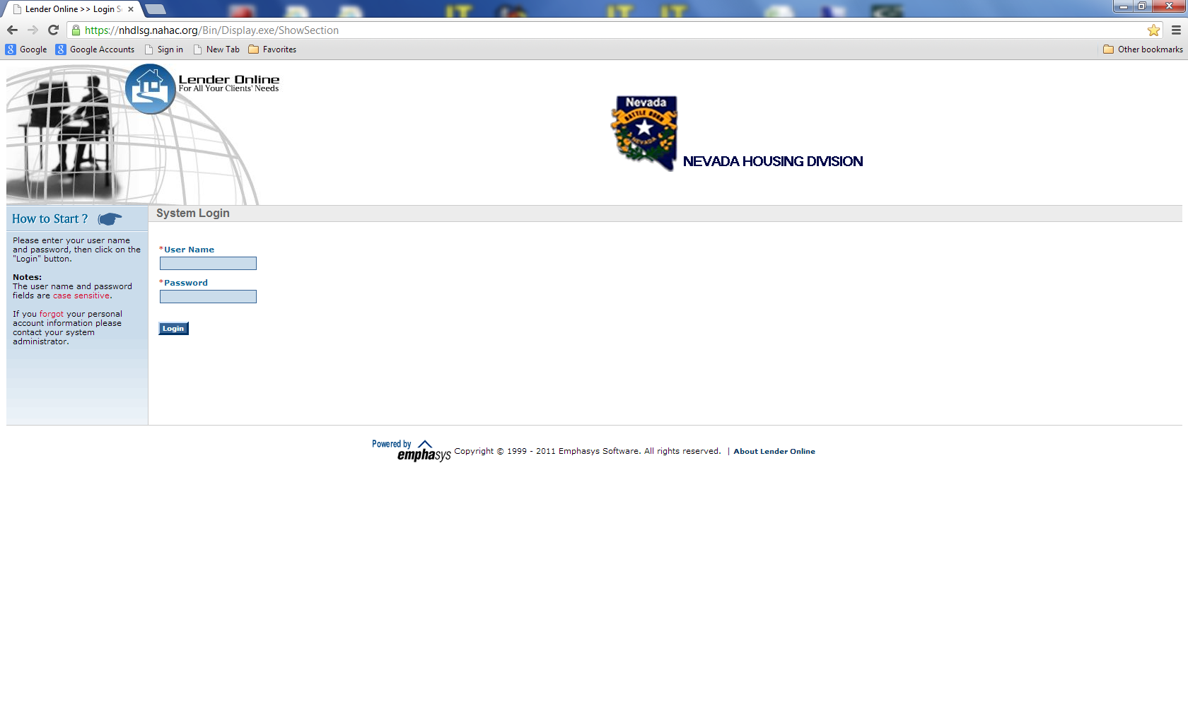
Enter User Name and Password and click on [Login]

Slide 6
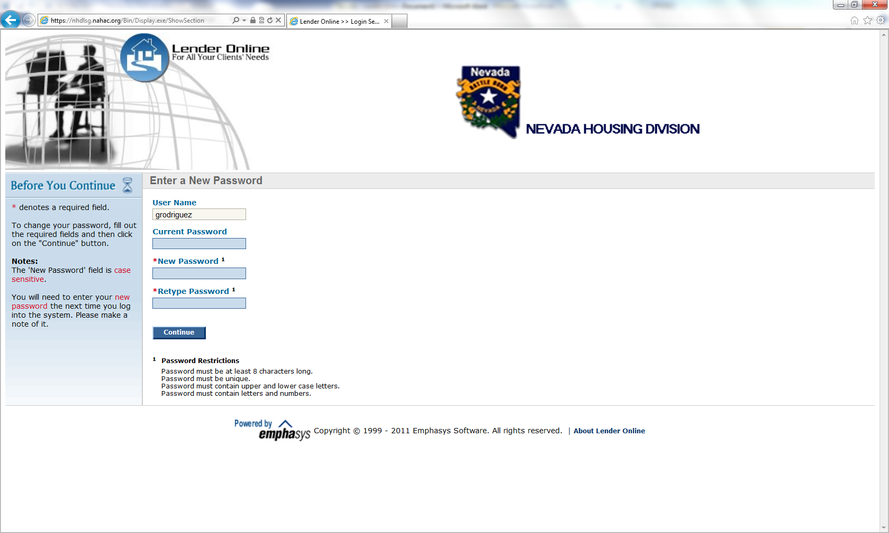
User will be required to once again enter their “temporary” password and then change and confirm the new password…

Slide 7
Tabs & Functions

Slide 8
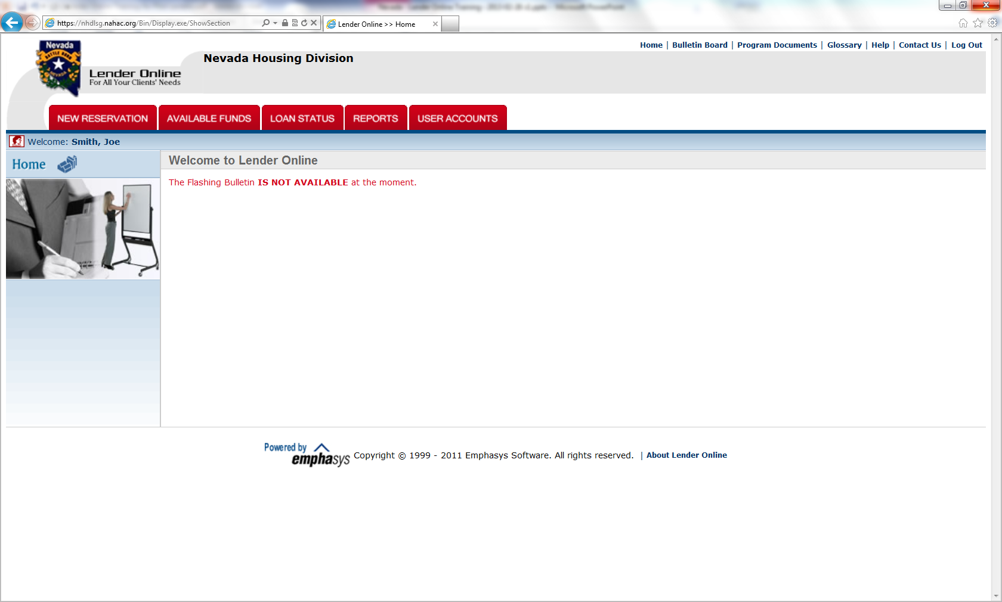
Link not active at the moment

Slide 9
Upper Right Corner Links
Home – Takes user back to the initial site landing page
Bulletin Board – Gives updated instructions or important program changes to you, our lenders, in chronological order
Program Documents – Location of manuals and program documents (NHD Web Site)
Glossary – Pertinent industry standard terms defined
Help – Navigational tool for Lender Online usage
Contact Us – Link to our address and contact person
Log Out – Clink to quickly sign off site

Slide 10
User Account Management

Slide 11
User Accounts Tab
Admin appointed users will select the “User Accounts” tab to set up new users and to edit/inactivate old ones. Non-admin level users will not see this tab when they sign in.

Slide 12
User Account Management
This screen appears when the “User Accounts” tab is clicked...

Slide 13
Adding, Deleting & Editing Users
Select the Users/Contacts button under “Other Accounts”. This will result in a global view of all users signed up under your lender account.
You may print out a list or search by a name once users are set up.
Select Add, edit, or delete a user by selecting the appropriate action key pictured to the lower left.

Slide 14
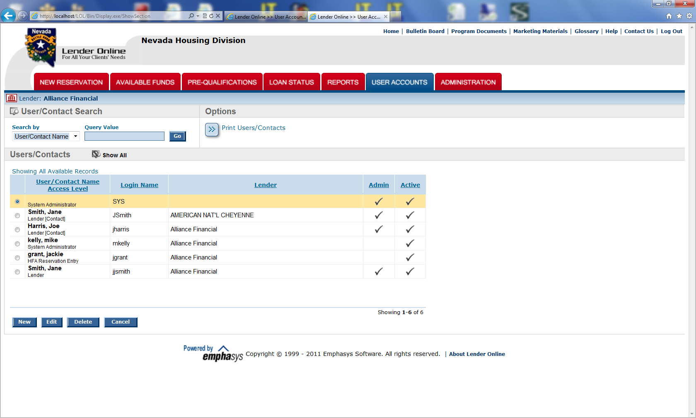
Sample User List

Slide 15
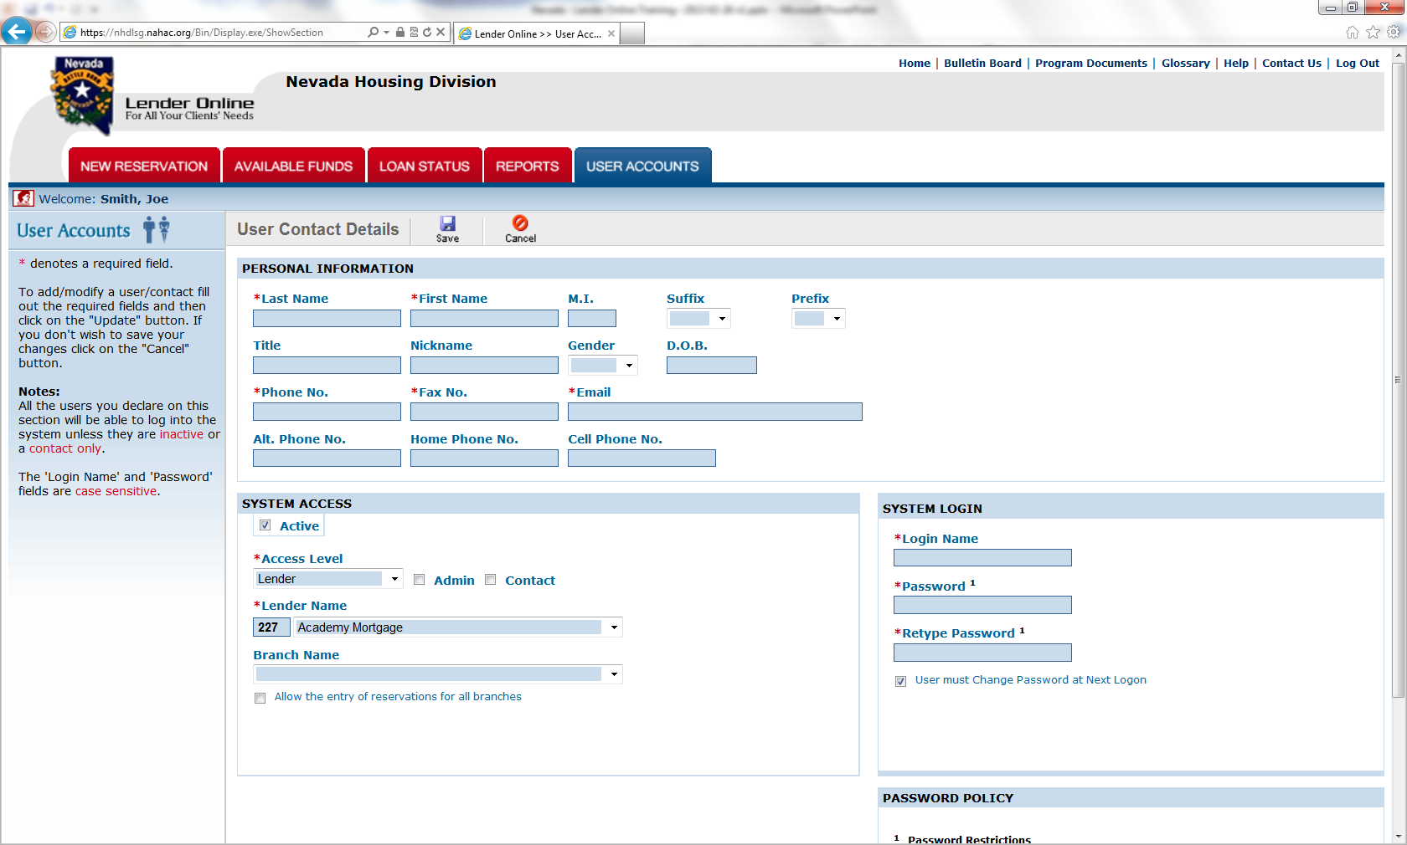
Sample User Account Screen

Slide 16
New User Input Instructions
All asterisked (*) fields must be entered
You must select an “Access Level” from the drop down box (Levels are explained in the next slide)
Once the access level is selected, it will open up new fields, including a branch name. NHD recommends that you assign a user to their branch location, when applicable
You must give them a permanent user name and a temporary password, which they will be prompted to change at initial login
Don’t forget to <Save> your changes and additions

Slide 17
Most Used “Access” Levels
Clerk: Can view bulletins, program documents and loan status information. Can enter new reservations.
Officer: Can view bulletins, program documents and loan status information. Can run and print reports, but only for loans associated with the officer as an individual. Can enter reservations.

Slide 18
Most Used “Access” Levels
Branch: Can view bulletins, program documents and loan status information. Can run and print reports, but only for the branch of the lender institution that the user belongs to. Can enter reservations.
Lender: (Full access to all production) Can view bulletins, program documents and loan status information for all branches. Can run and print reports for the entire lender institution. Can enter reservations. Can authorize other users to access the system at the 'Lender' or lower levels. (Only when the Admin checkbox is checked.

Slide 19
Available Funds

Slide 20
Available Funds Tab
This tab is used to display all NHD programs, such as the first time homebuyer, teacher’s first payment assistance, etc. with funds available for reservations.
If you are unable to reserve a loan because of lack of funds, verify that you have selected the most current bond issue under that program

Slide 21
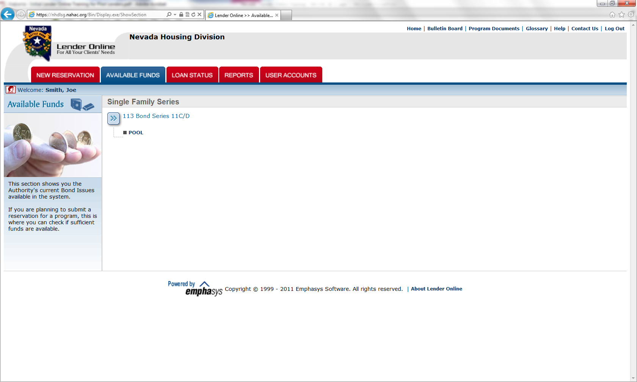
Sample Available Funds Screen
Click to see available funds…

Slide 22
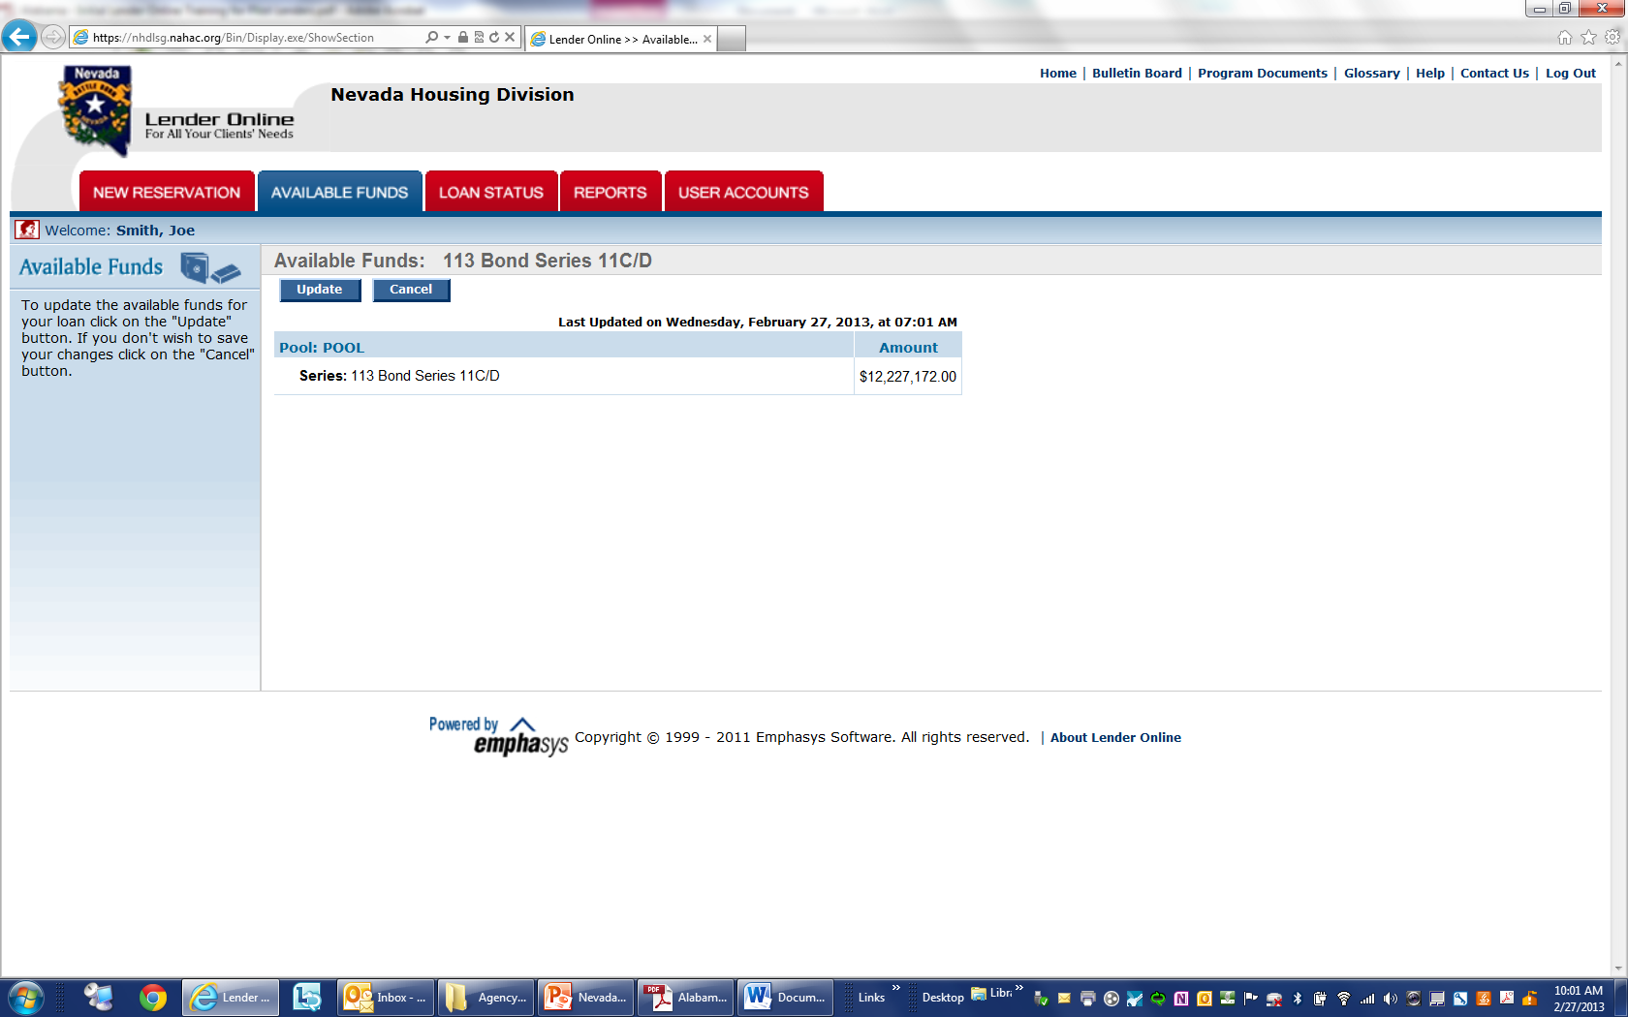
Picture in Time
Click to refresh…

Slide 23
New Reservation

Slide 24
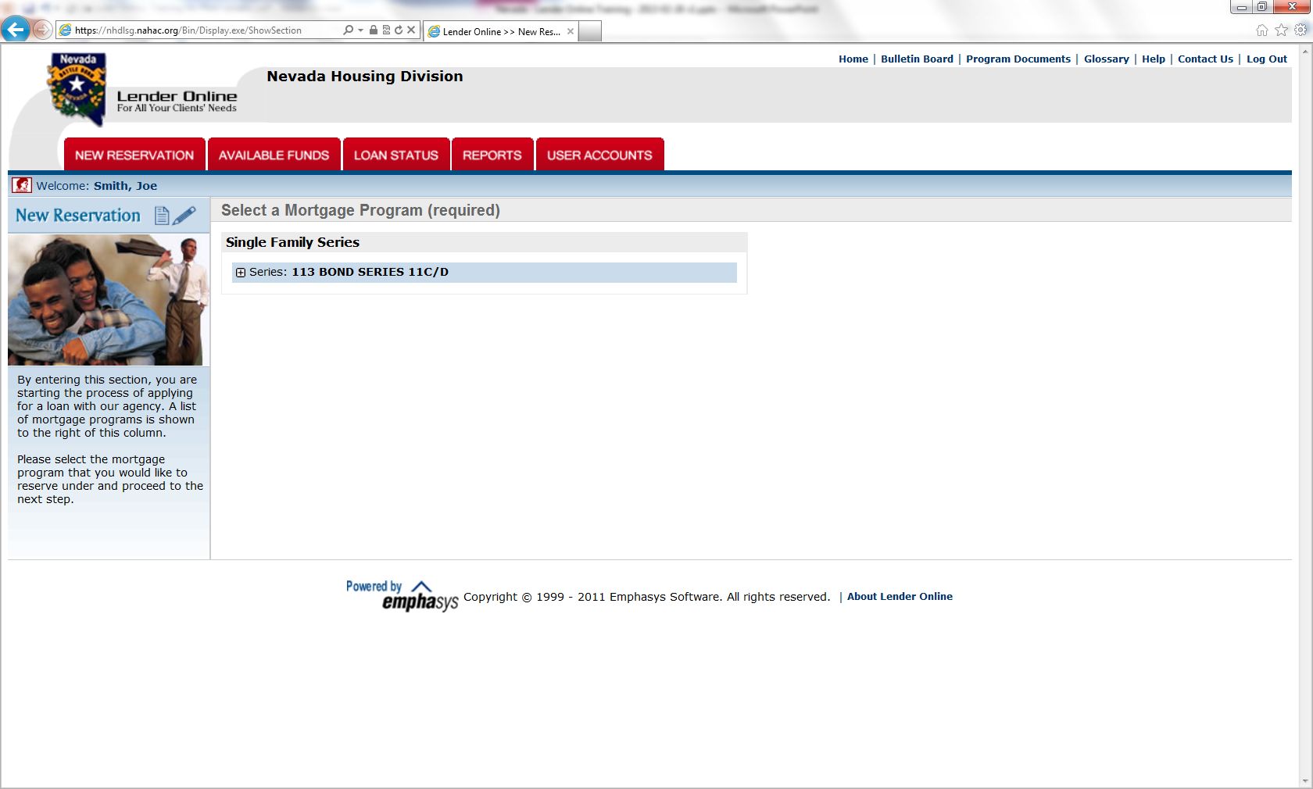
Sample New Reservation Screen

Slide 25
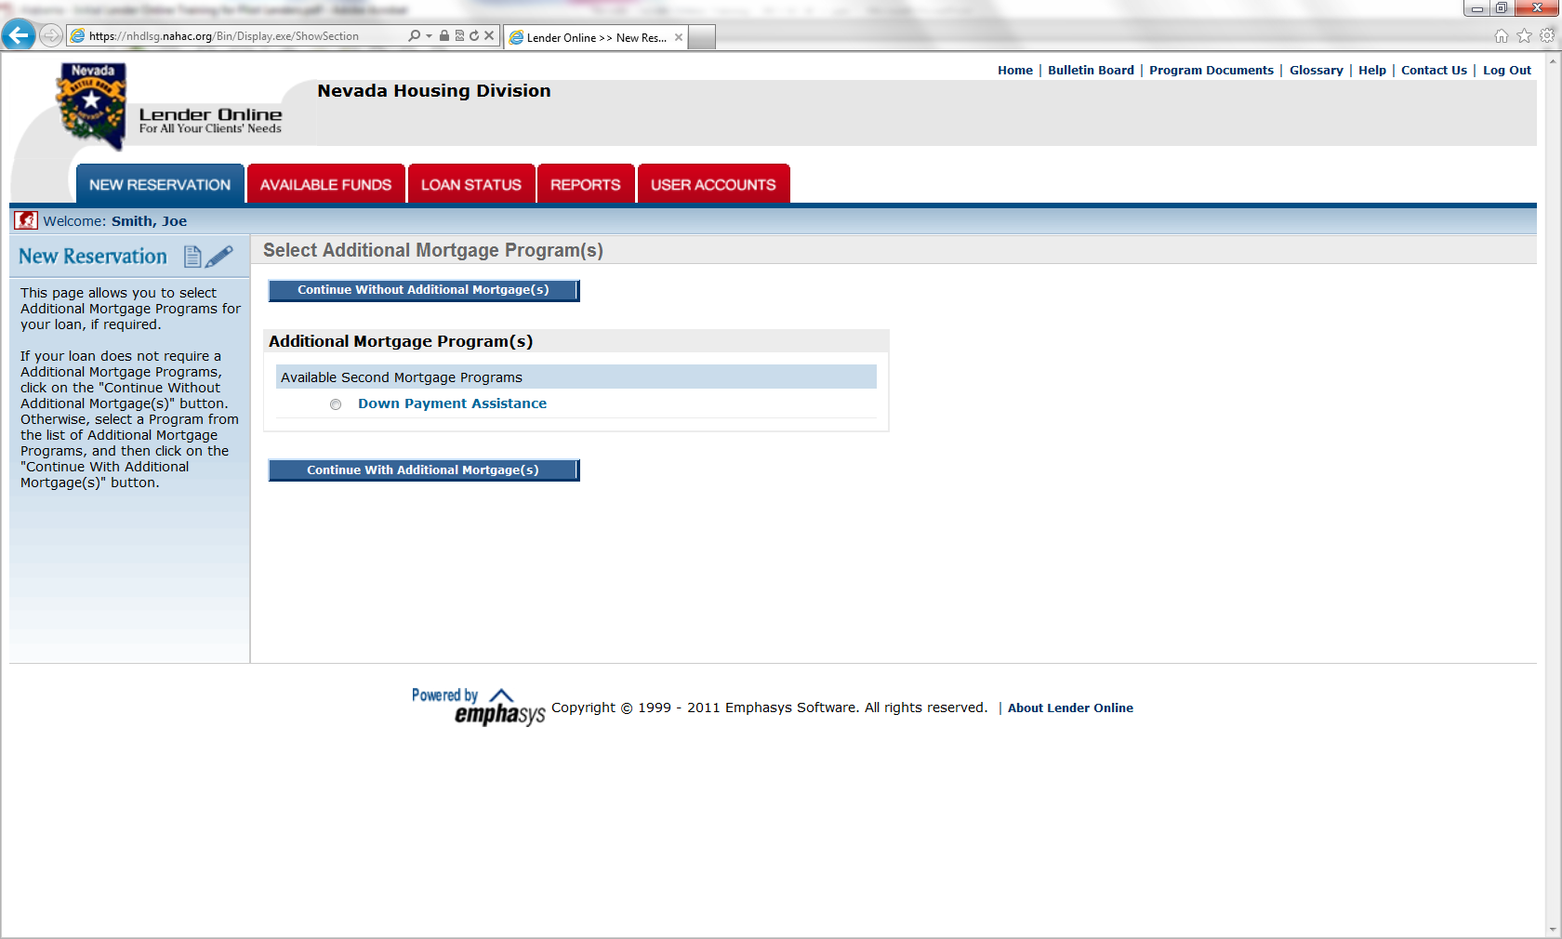
“With” or “Without” DPA
Click to continue…”No” DPA
Select a DPA and Click to continue…

Slide 26
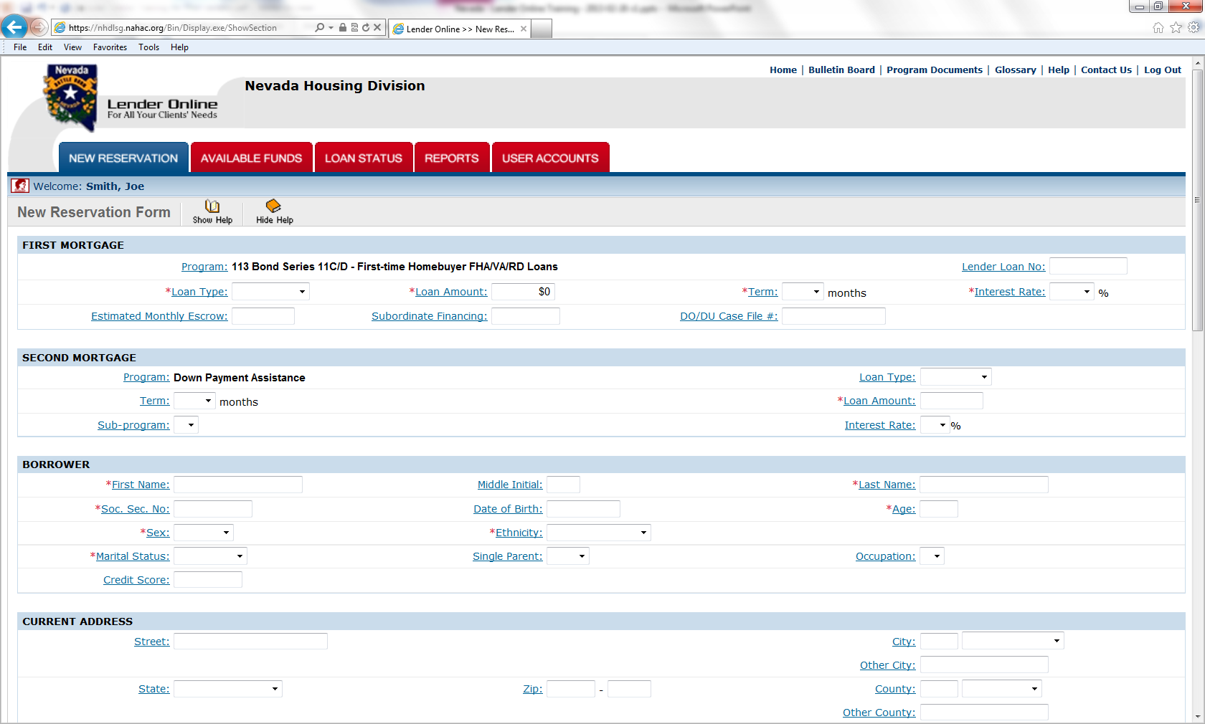
Sample New Reservation Entry…

Slide 27
New Reservation “Tips”
All fields with an asterisk (*) must be entered or the reservation will be denied
NOT USE THE BACK ARROW KEY or you will lose the web connection and all of the information you’ve keyed
All of the information required to get a reservation is on this one screen
Please insert a “-” between double last names (i.e. Smith-Jones) when entering the borrower & co-borrower last names
Complete required fields and click the <Summit> button at the bottom of the screen to register the loan.
The screen will come back with “YOUR RESERVATION HAS BEEN ACCEPTED

Slide 28
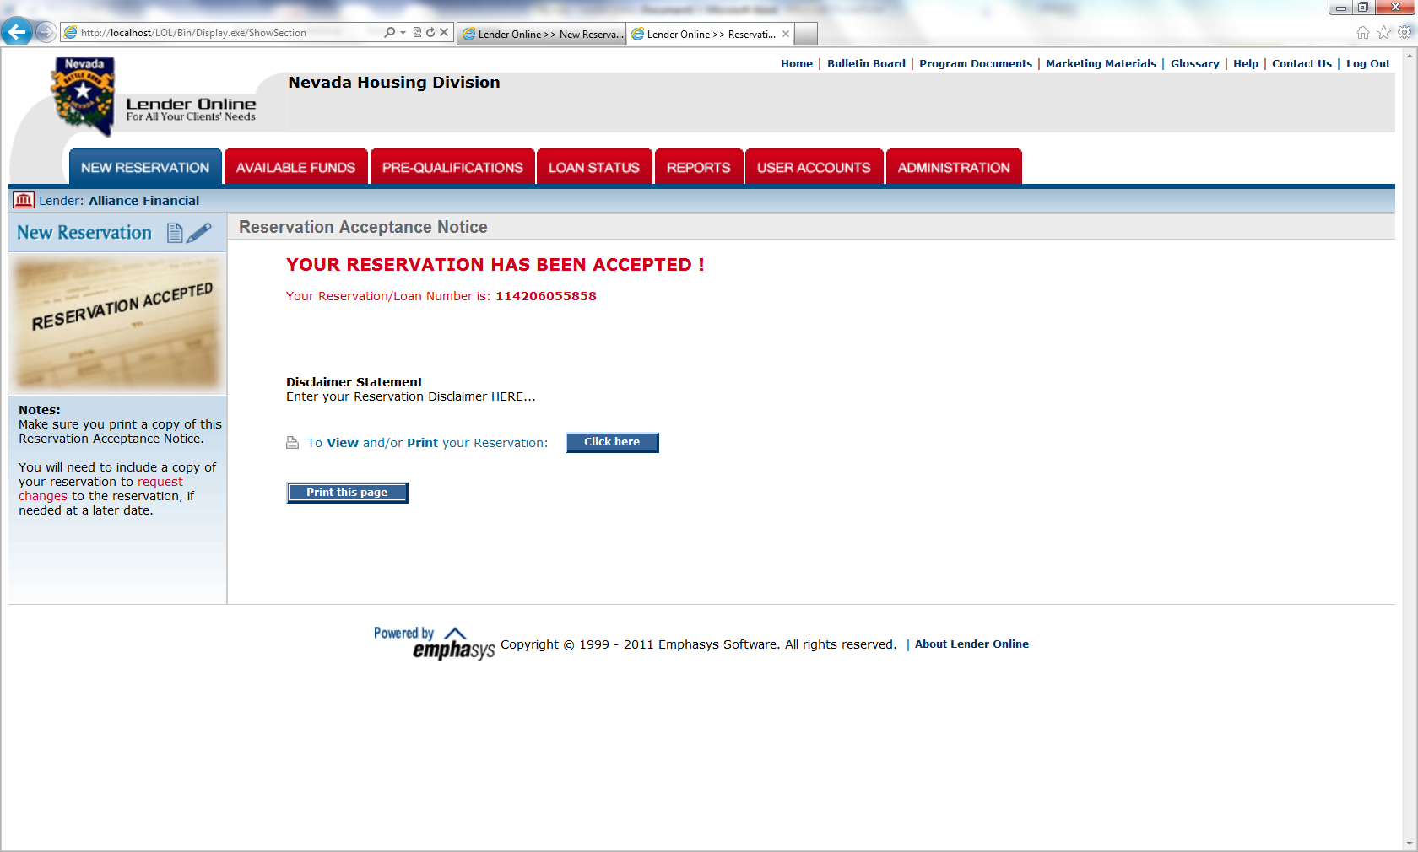
Sample Reservation “Accepted”
Click and print the Reservation Form. This document must be included in the compliance submission package.

Slide 29
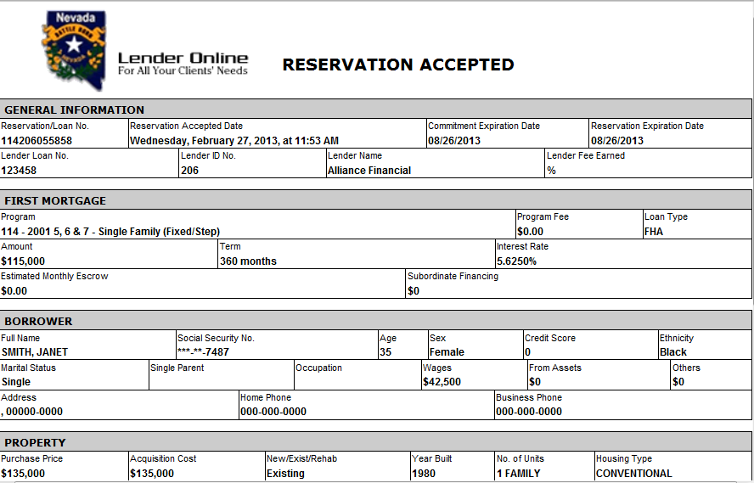
Sample Reservation “Form”

Slide 30
What comes Next?
Review the reservation data. You will not be able to edit this record. Any future changes will be made by NHD.
You may line through any incorrect data on the printed reservation form. In red, write the correct information on the form to include in the submission file. NHD will make the changes.

Slide 31
Loan Status

Slide 32
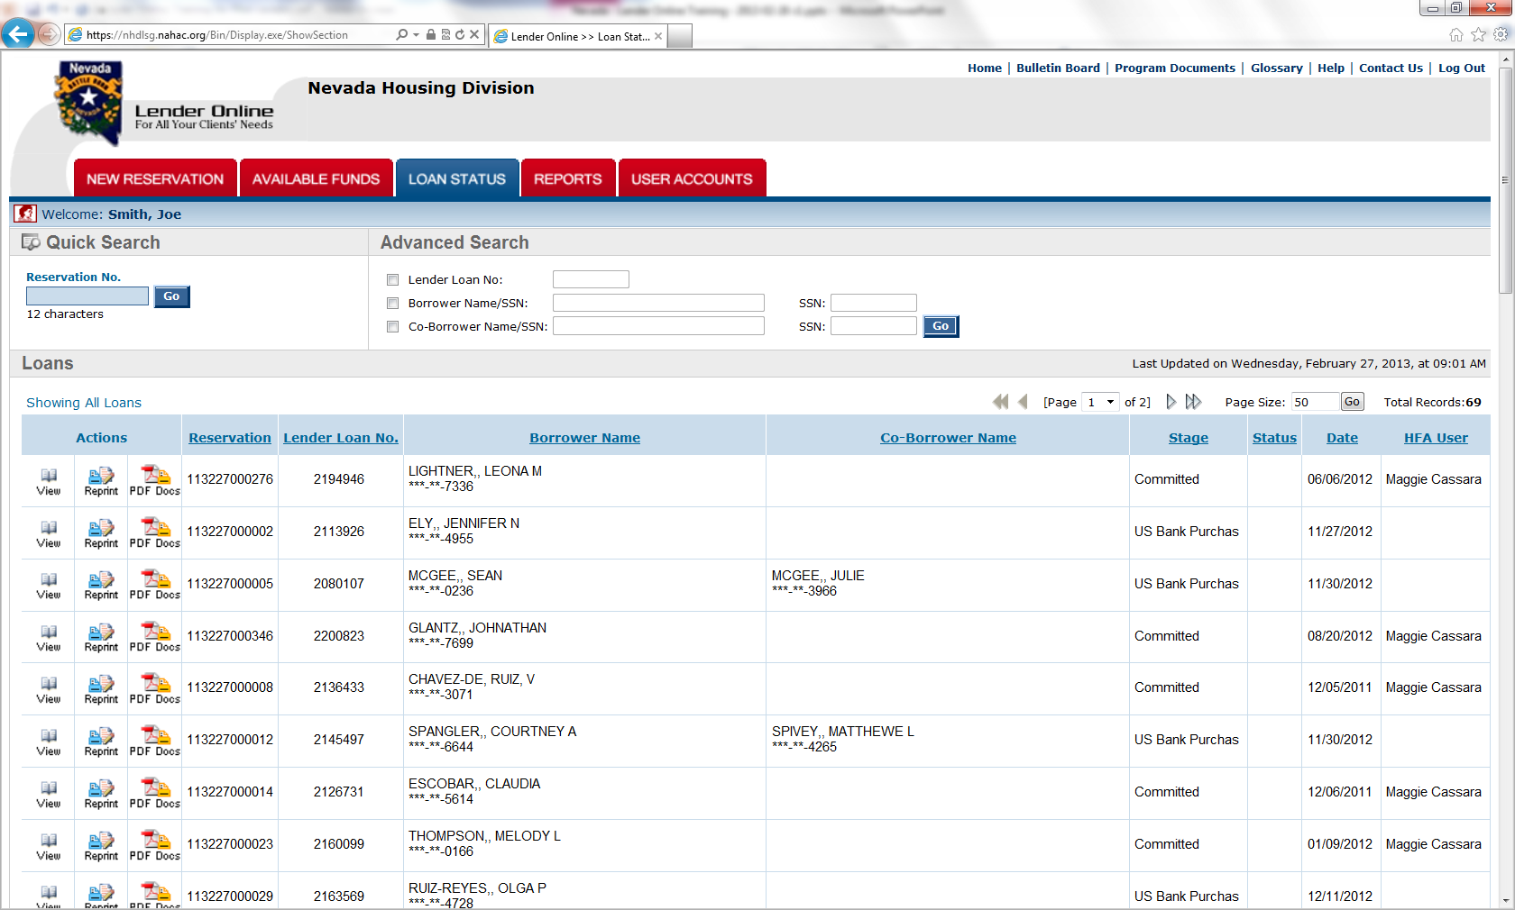
Loan Status Tab

Slide 33
Check the Status…
Locate your Reservation/loan by using the Quick Search
Click on the <View> button for more in-depth information
Click on the <Reprint> button to print the Reservation Form

Slide 34
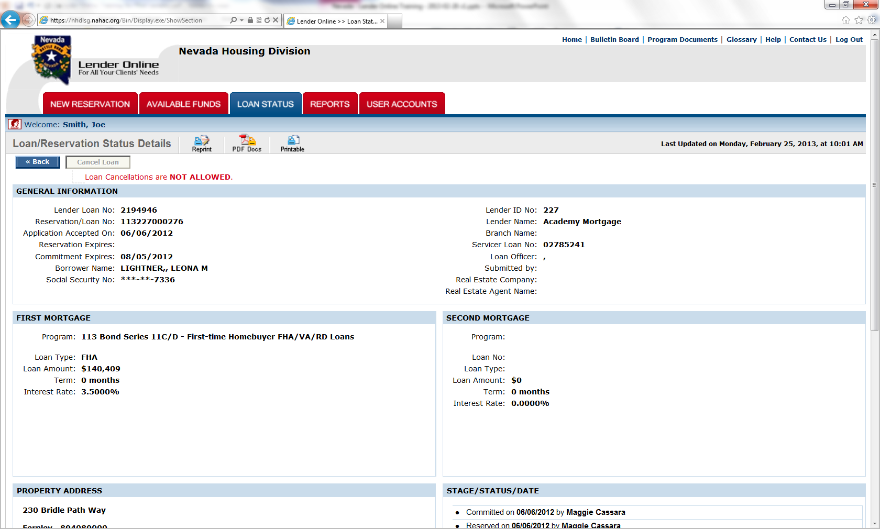
Sample Loan/Reservation Status

Slide 35
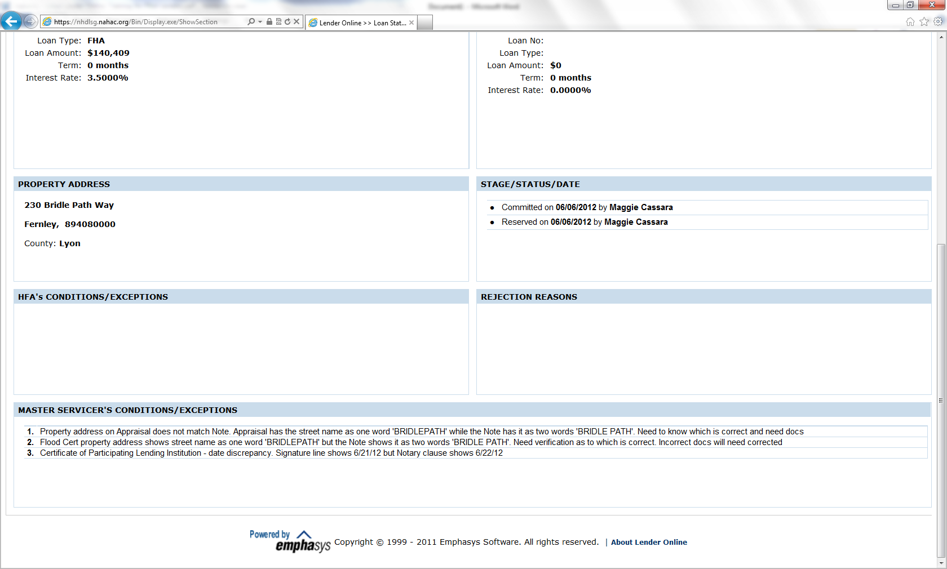
Continued…
Lenders will be able to see the current status on each loan, as well as any conditions needed to provide for an approval, or as closing conditions.

Slide 36
Reports

Slide 37
Available Reports
HFA Conditions/Exceptions
Master Servicer Conditions/Exceptions
Commitment Expiration
Current Stage Status
Purchase Advice

Slide 38
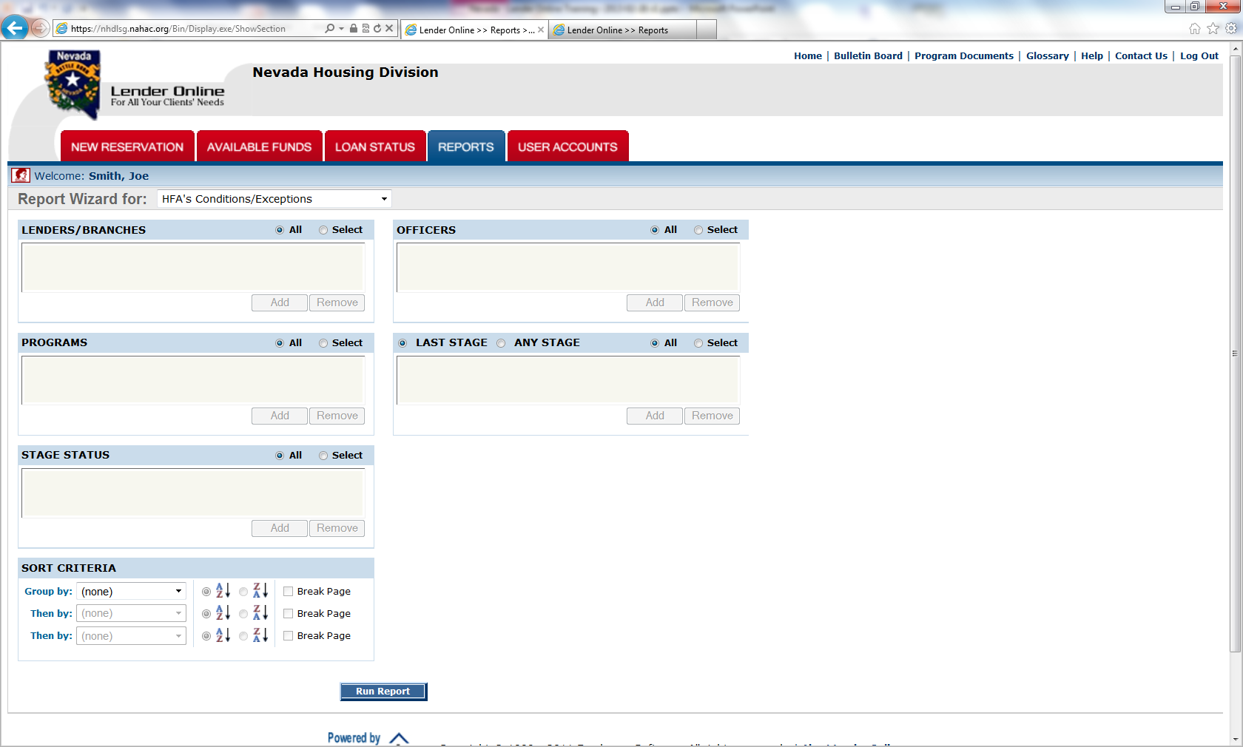
Sample Report Selection Screen

Slide 39
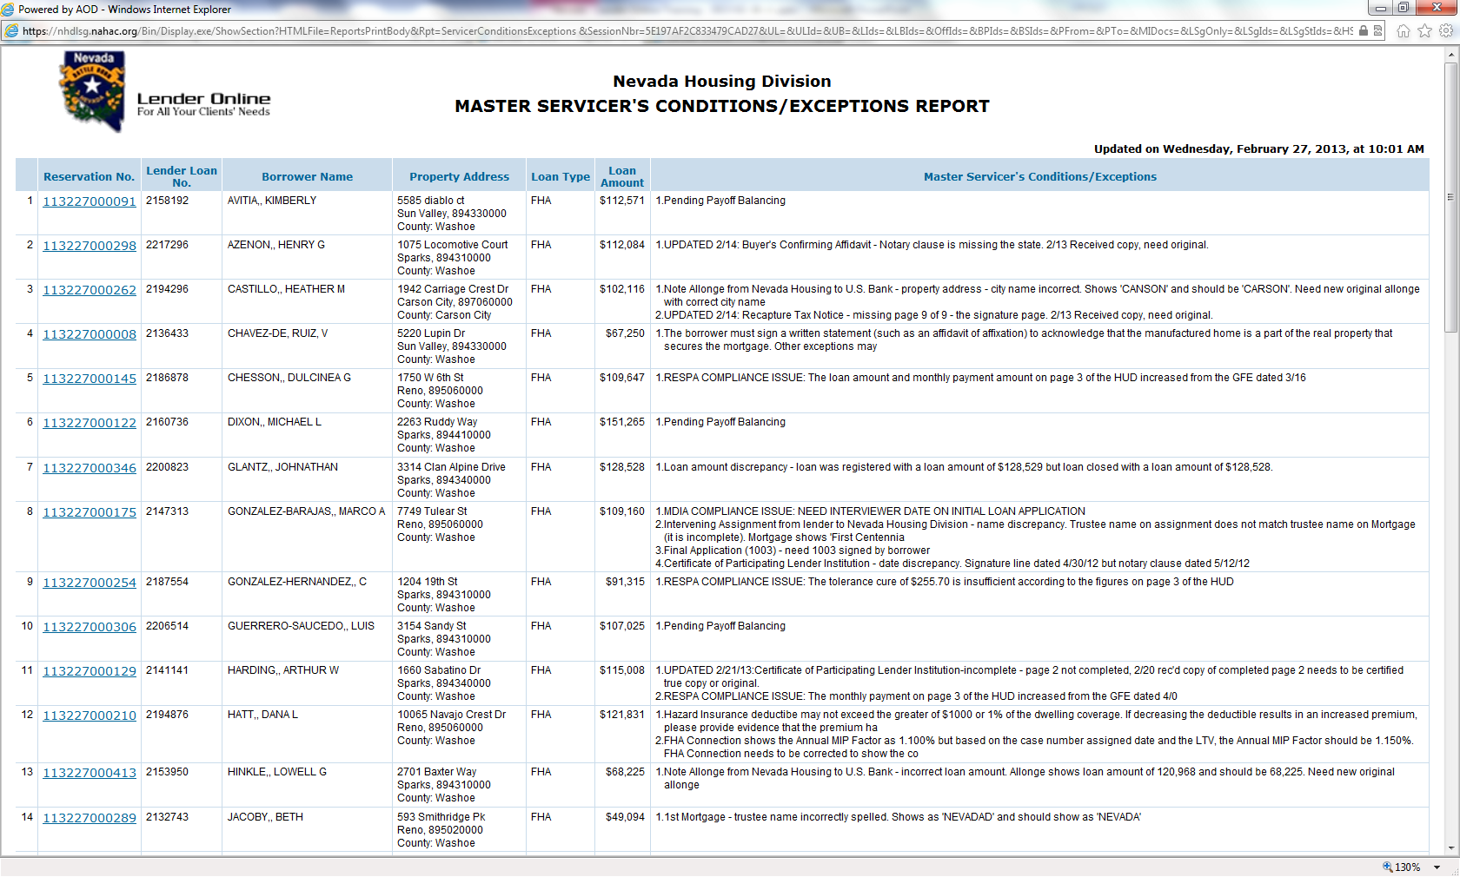
Sample Report

Slide 40
PROGRAM HIGHLIGHTS
Program Highlights
FHA, VA Min FICO 640, HFA-Preferred (95.01% to 97%) FICO 680
Max DTI 45%
Household income maximums apply (see website for specifics)
Maximum Purchase Price apply (see website for specifics)
Down-payment assistance layering allowed (have to go in 3rd position behind NHD DPA loan
Participating Lender closes loan and funds First Mortgage. NHD table funds 2nd Mortgage. See lender forms and stack sheet’s for file order and required documents at http://housing.nv.gov/programs/FTH/Lender_Forms/
Buyer MUST obtain Homebuyer Education Certificate (expiration date must be after COE on certificate)
Manual UW allowed for “NO SCORE “on FHA and VA loans. NOT allowed on HFA-Preferred loans
SFR, Condo’s, PUD, townhomes, Manufactured housing allowed. No Condo’s allowed on HFA-Preferred Loans
Non-borrowing spouses MUST sign ALL NHD forms
Manual, forms, brochures, bulletins, etc. are on website at
http://housing.nv.gov/programs/FTH/Lender_Information/

Slide 41
Questions
Do not make reservations on the portal prior to that date. Lender Portal questions, contact:
Nnika Cromwell at: ncromwell@housing.nv.gov
Maggie Cassara at: mcassara@housing.nv.gov

