Slide 1
Nevada Housing Division
First-Time Homebuyer Down-payment Assistance Loan

Slide 2
The Purpose of this Training
Explain the benefits of why You as the participating lender should offer the NHD First-time homebuyer loan to your clients
How to register a loan thru the Online-Portal
How to submit the Compliance File to NHD
Program fees, general parameters etc
NHD funding process for the 2nd DPA loan
Submitting the Post closing Purchase file to US Bank our Master Servicer (1st mortgage)

Slide 3
Program Highlights
Below market interest rate, currently 3.25%, 30 yr fixed for 1st mortgage
Low affordable payment for DPA 2nd mortgage at 5.25% fixed, amortized over 20 years
Hero-To-Home, Can use any program type 2.75%, 30 yr fixed for 1st mortgage, DPA 4.75%, 20 YR fixed
Up to 3% of the purchase price or appraised value whichever, is less for down-payment and or closing cost assistance
45% DTI allowed on the back-end
No borrower reserve requirements
Gift funds, seller credit and other DPA assistance allowed
Manual underwriting allowed for FHA, VA, RD loans with a true “no score” otherwise minimum FICO is 640. For Conventional HFA-preferred 680. And for manufactured housing a FICO of 660.
Over $13 MILLION in bond money still available to assistance Nevadans become Homeowners!

Slide 4
Register Loan’s thru the Online Portal https://lenders.housing.nv.gov/Bin/Display.exe/ShowSection

Slide 5
User Accounts Tab
Admin appointed users will select the “User Accounts” tab to set up new users and to edit/inactivate old ones. Non-admin level users will not see this tab when they sign in.

Slide 6
User Account Management
This screen appears when the “User Accounts” tab is clicked...

Slide 7
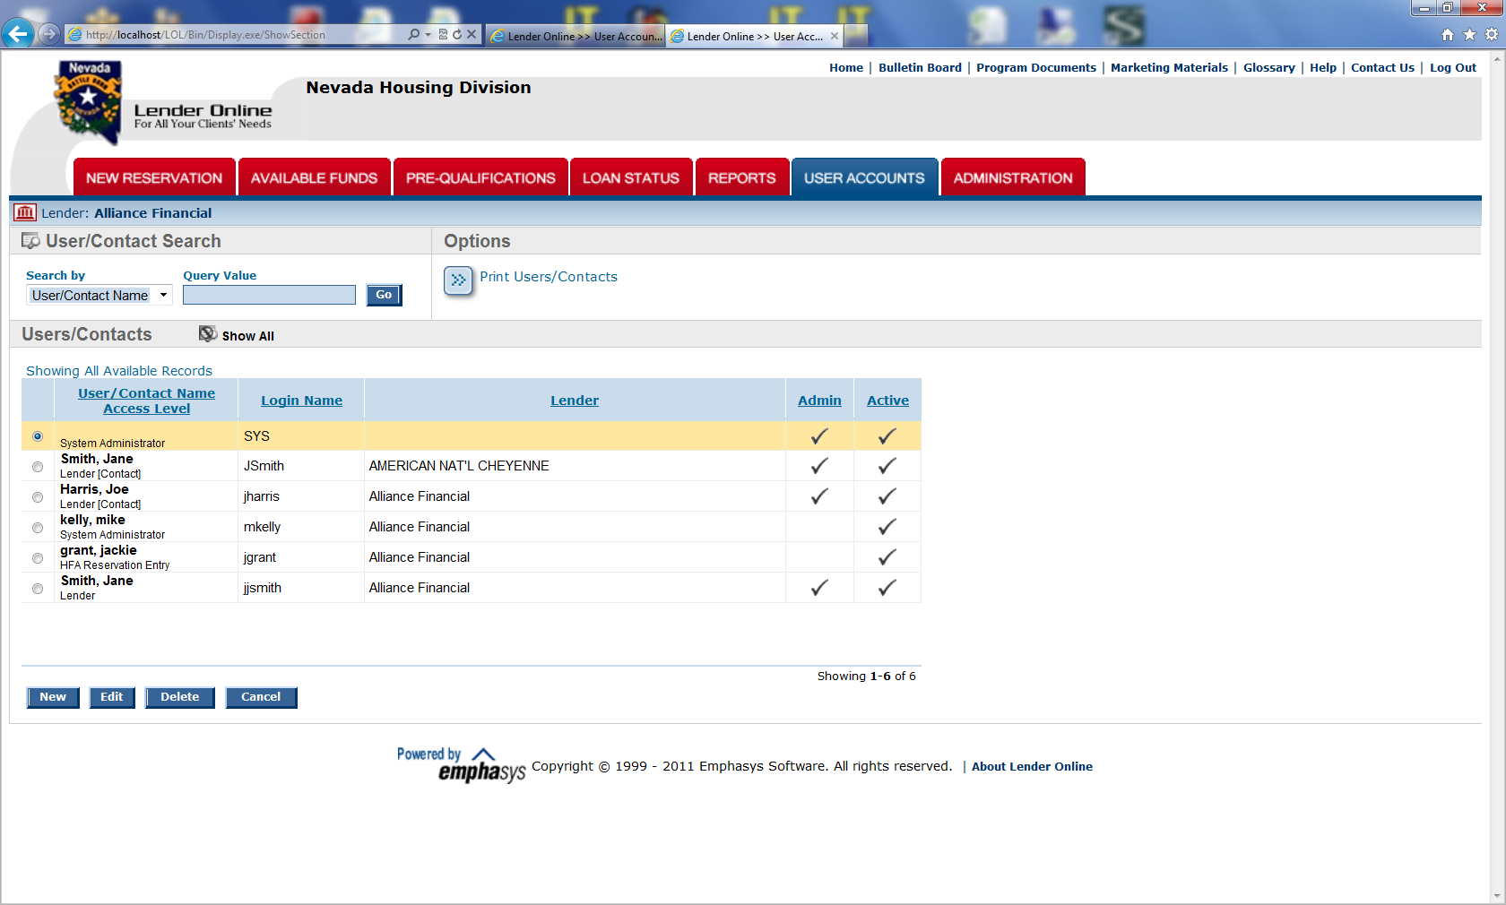
Sample User List

Slide 8
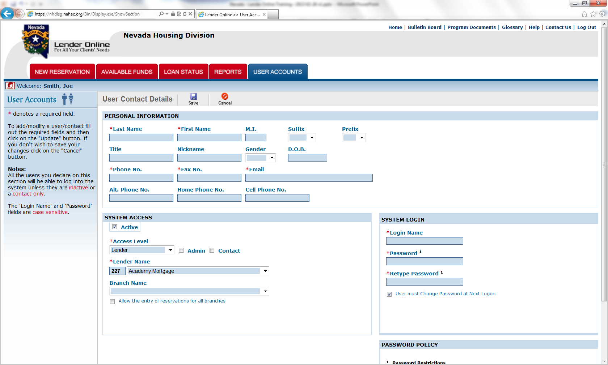
Sample User Account Screen

Slide 9
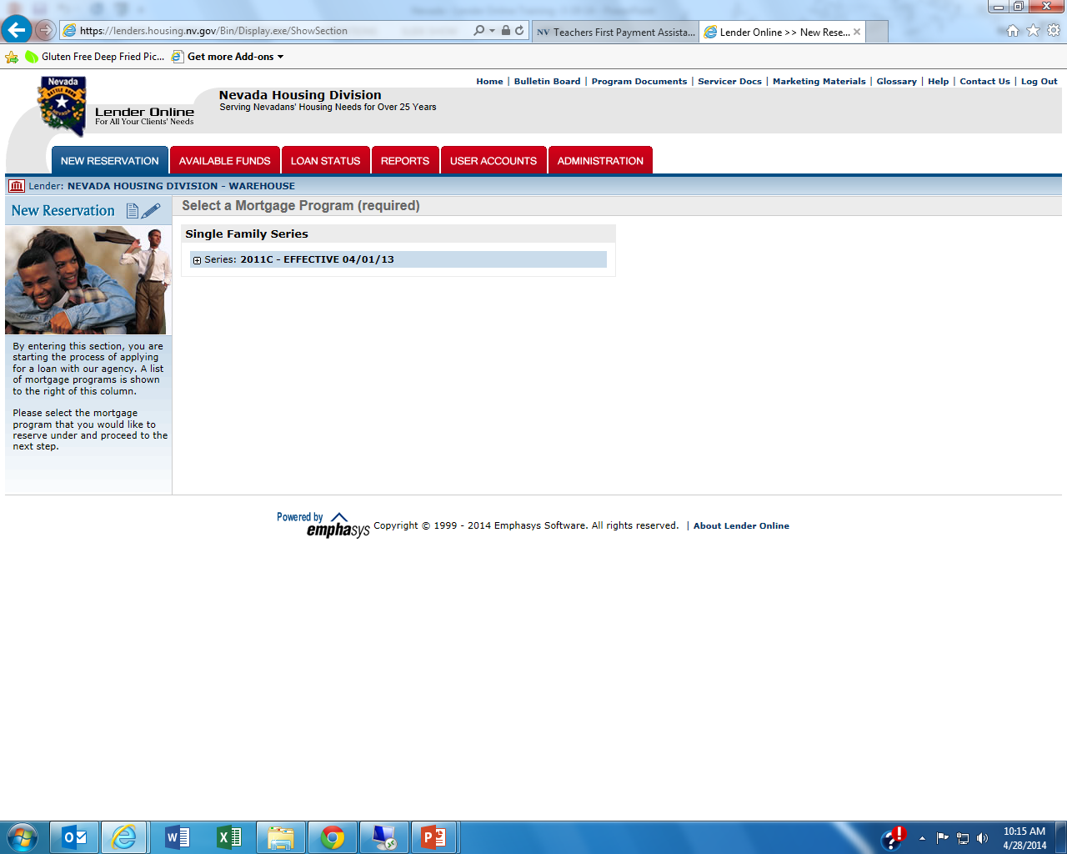

Slide 10
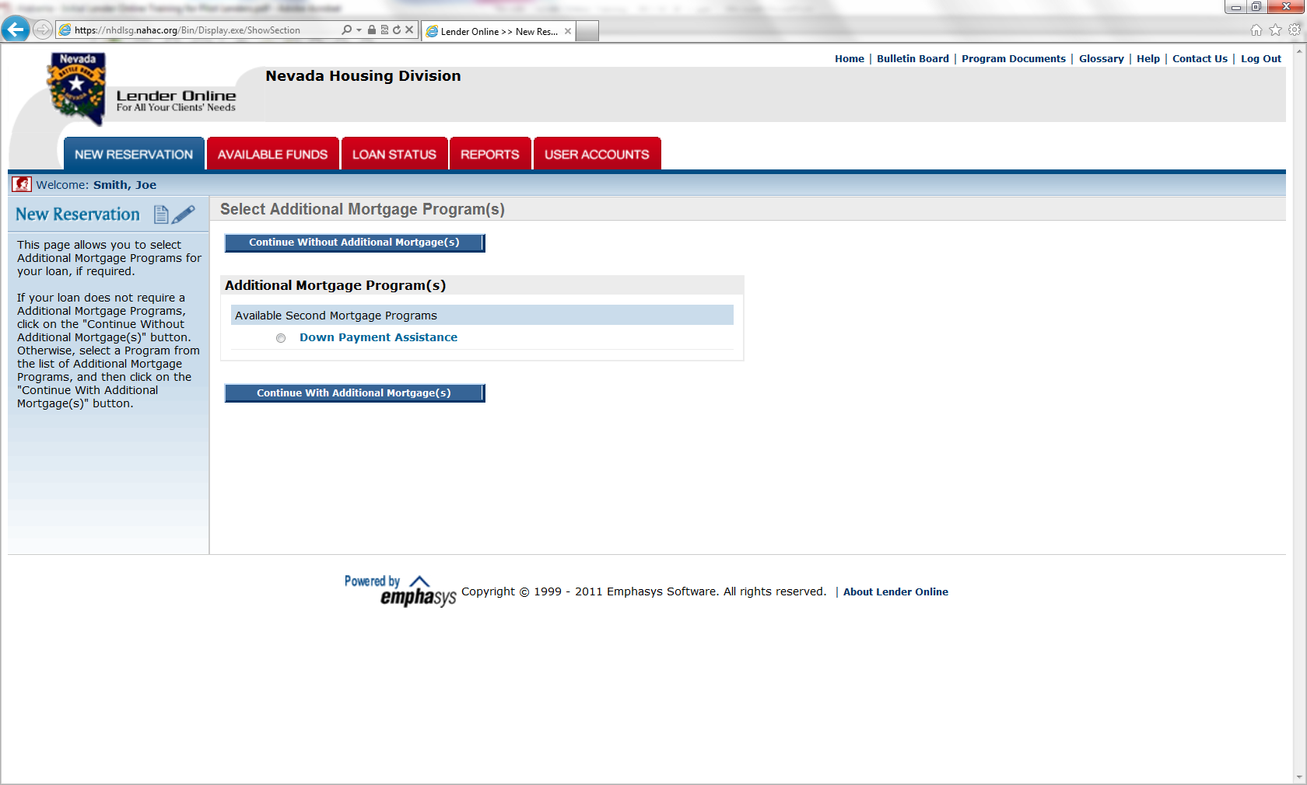
“With” or “Without” DPA
Click to continue…”No” DPA
Select a DPA and Click to continue…

Slide 11
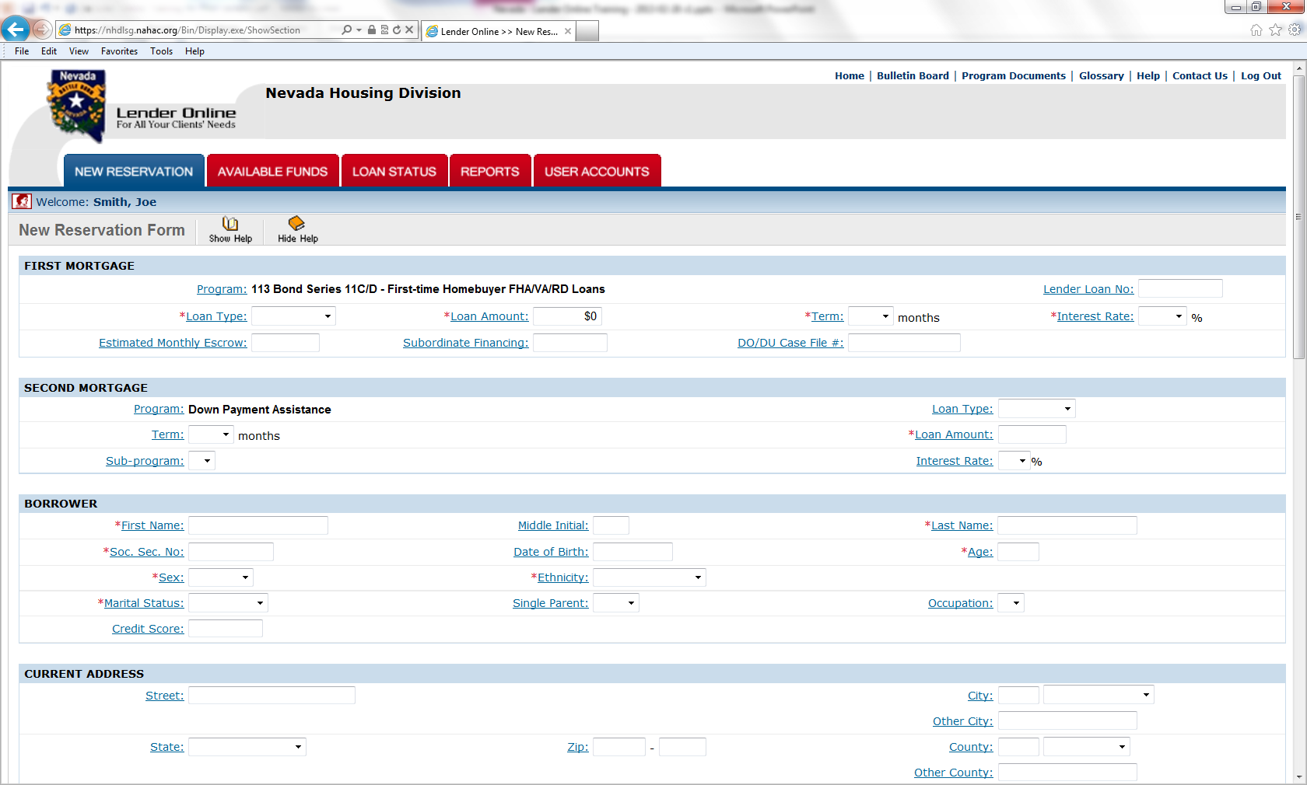
Sample New Reservation Entry…

Slide 12
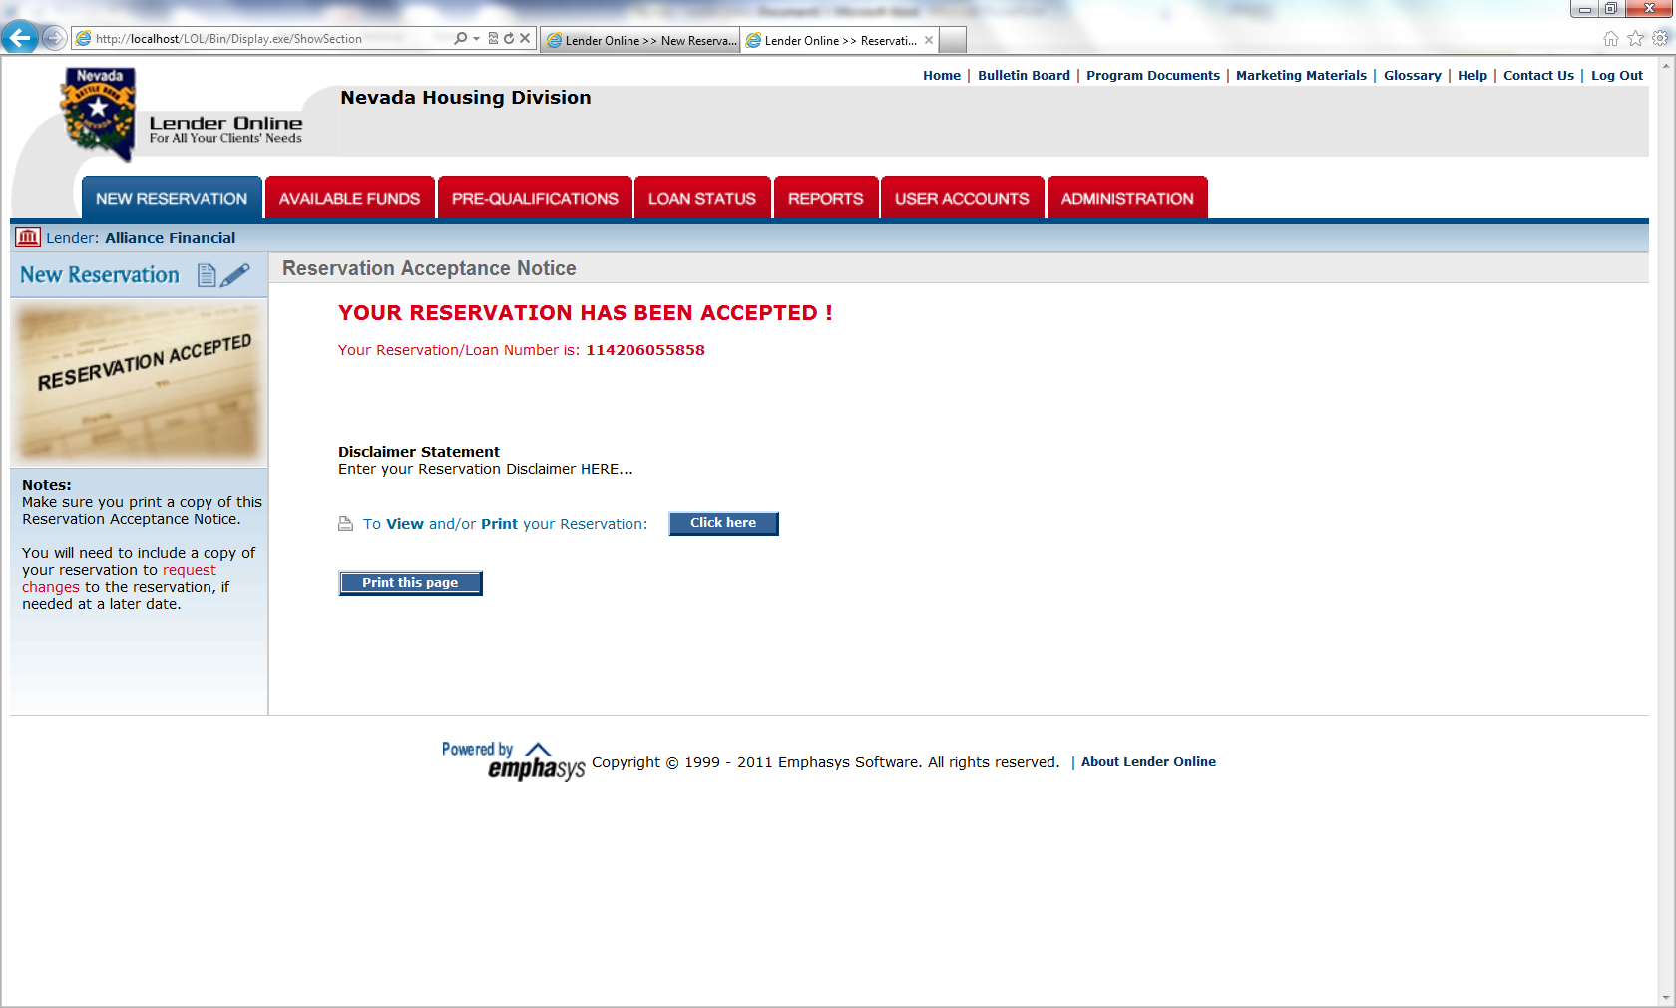
Sample Reservation “Accepted”
Click and print the Reservation Form. This document must be included in the compliance submission package.

Slide 13
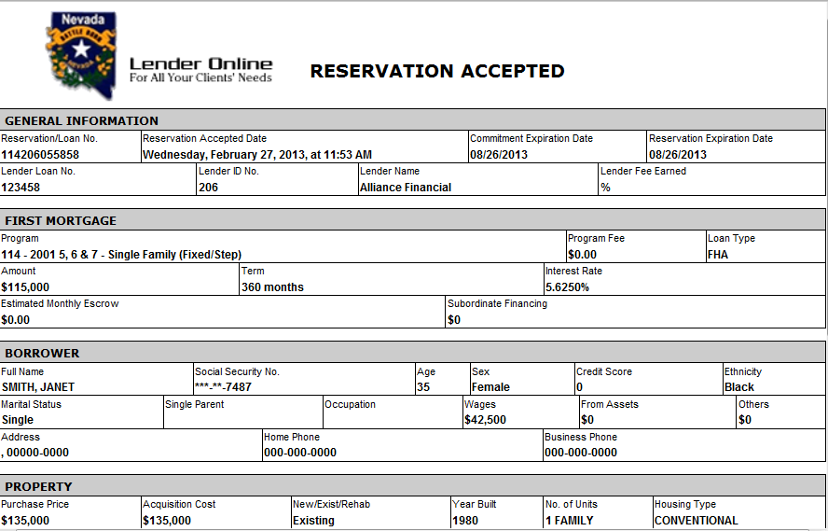
Sample Reservation “Form”

Slide 14
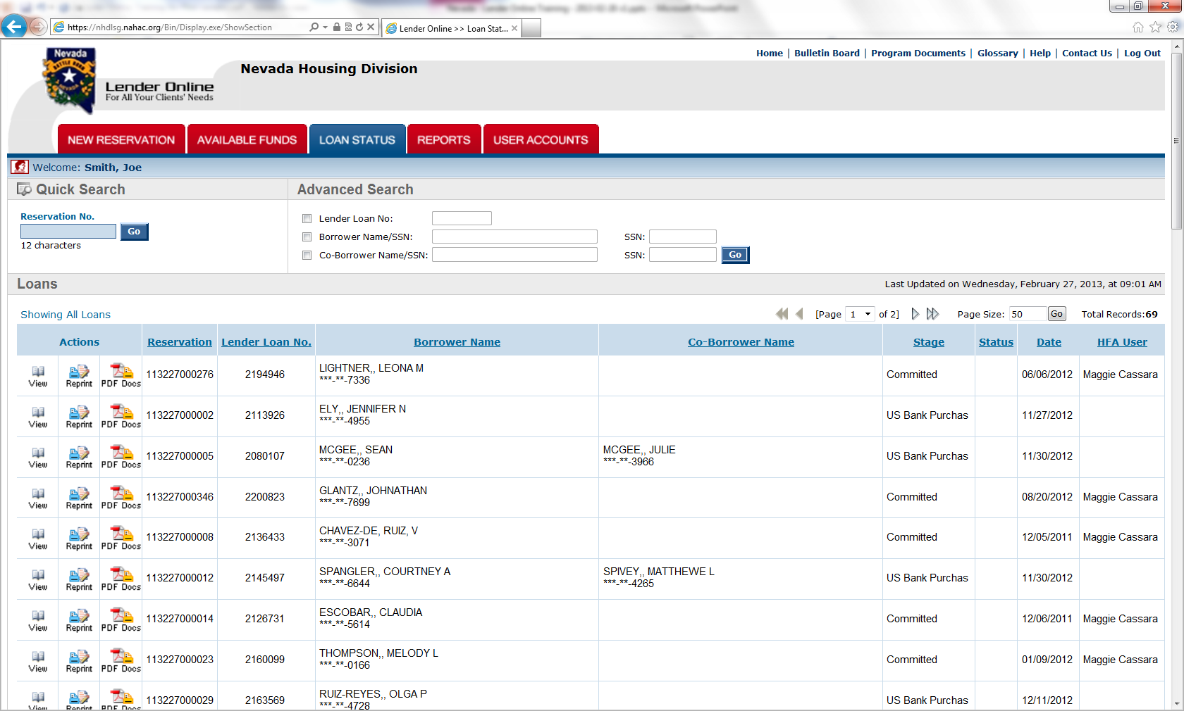
Loan Status Tab

Slide 15
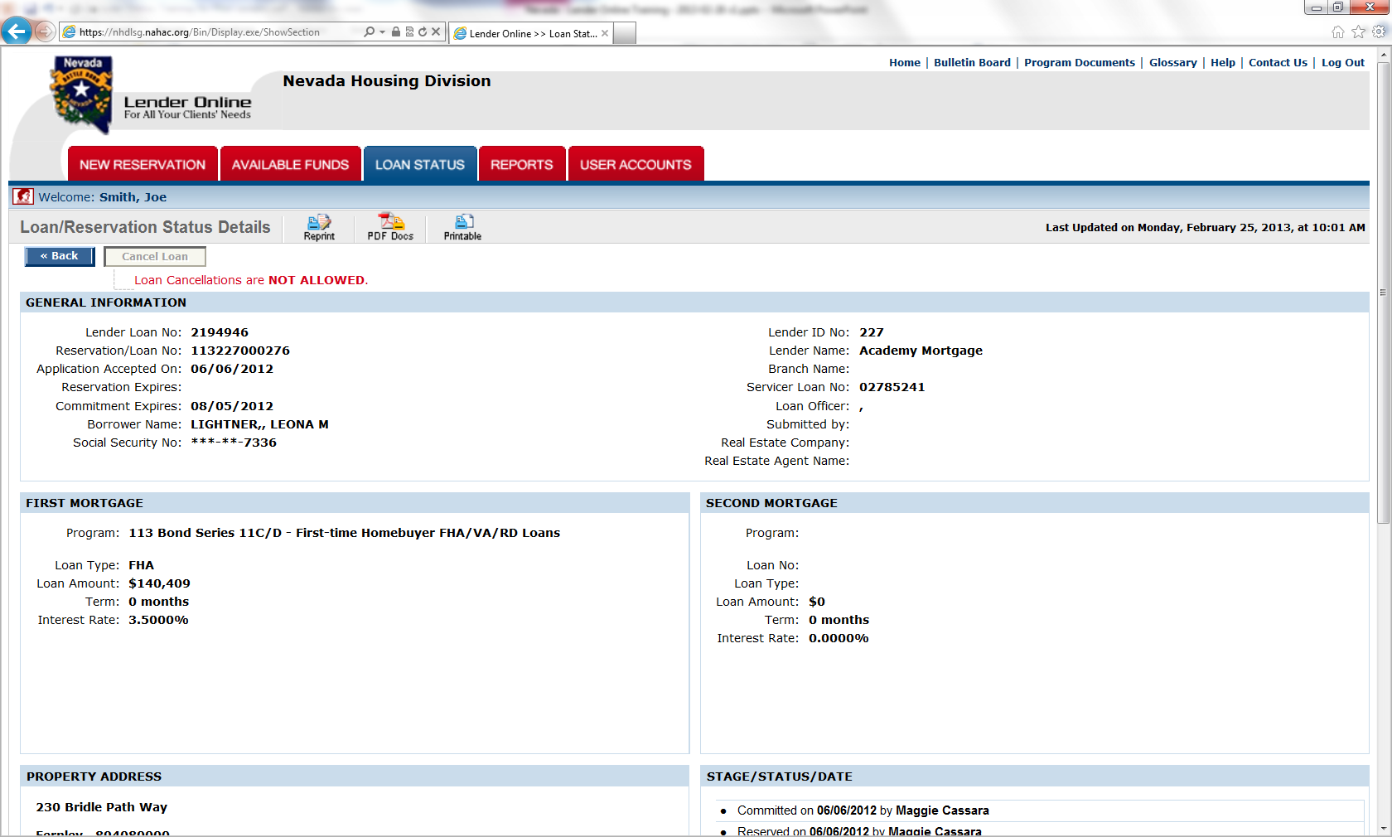
Sample Loan/Reservation Status

Slide 16
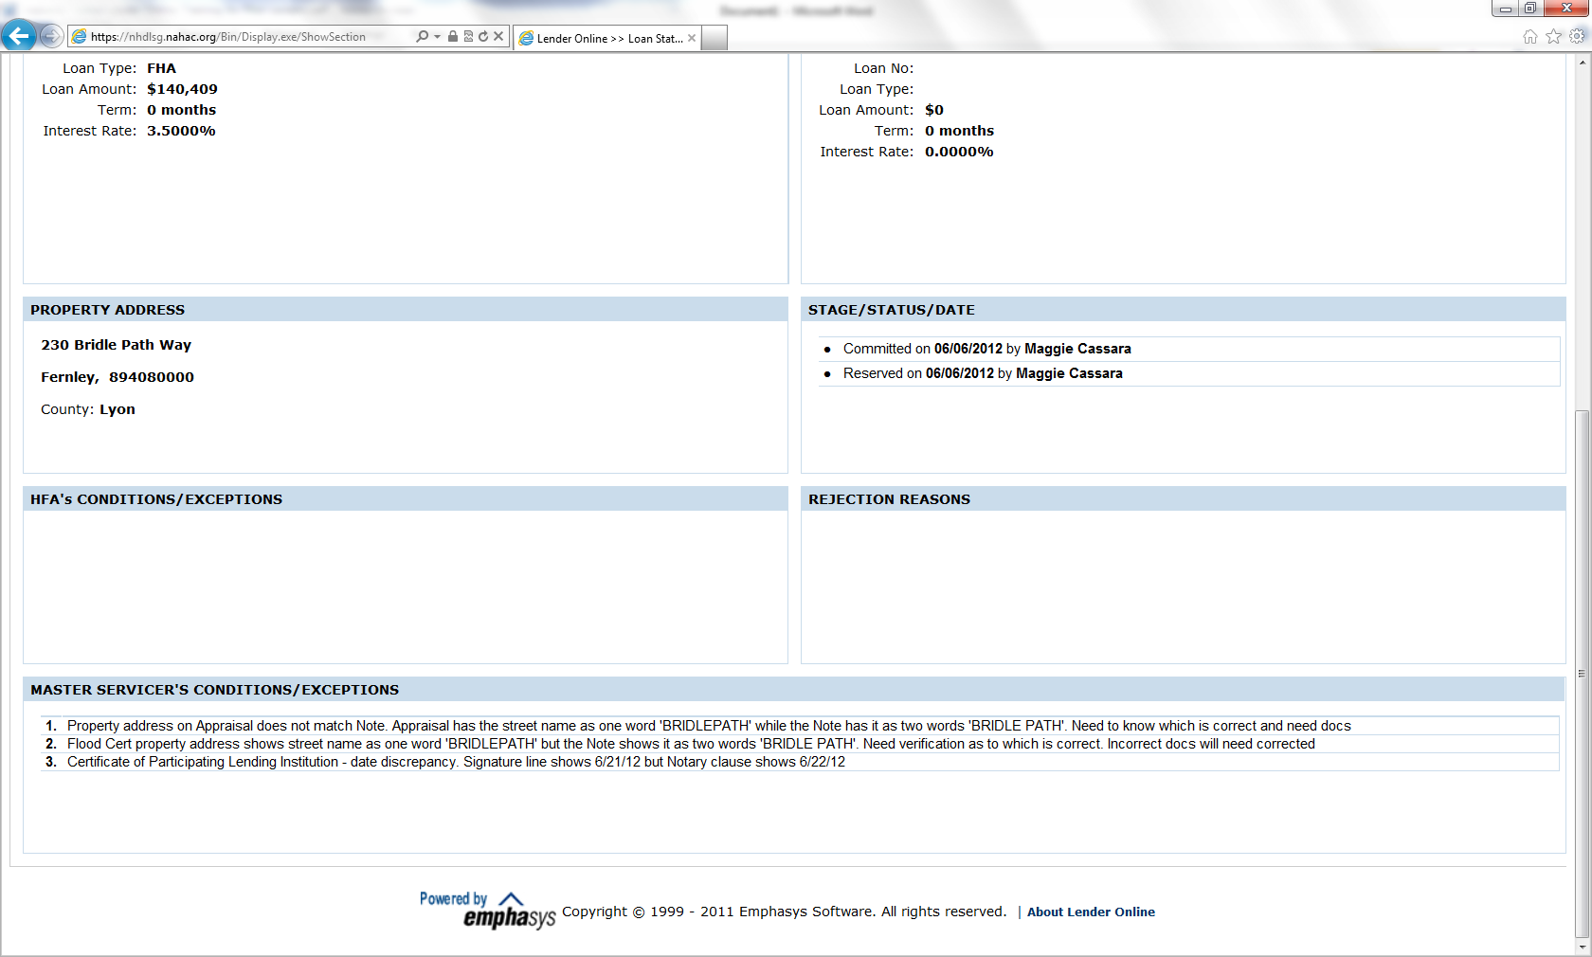
Continued…
Lenders will be able to see the current status on each loan, as well as any conditions needed to provide for an approval, or as closing conditions.

Slide 17
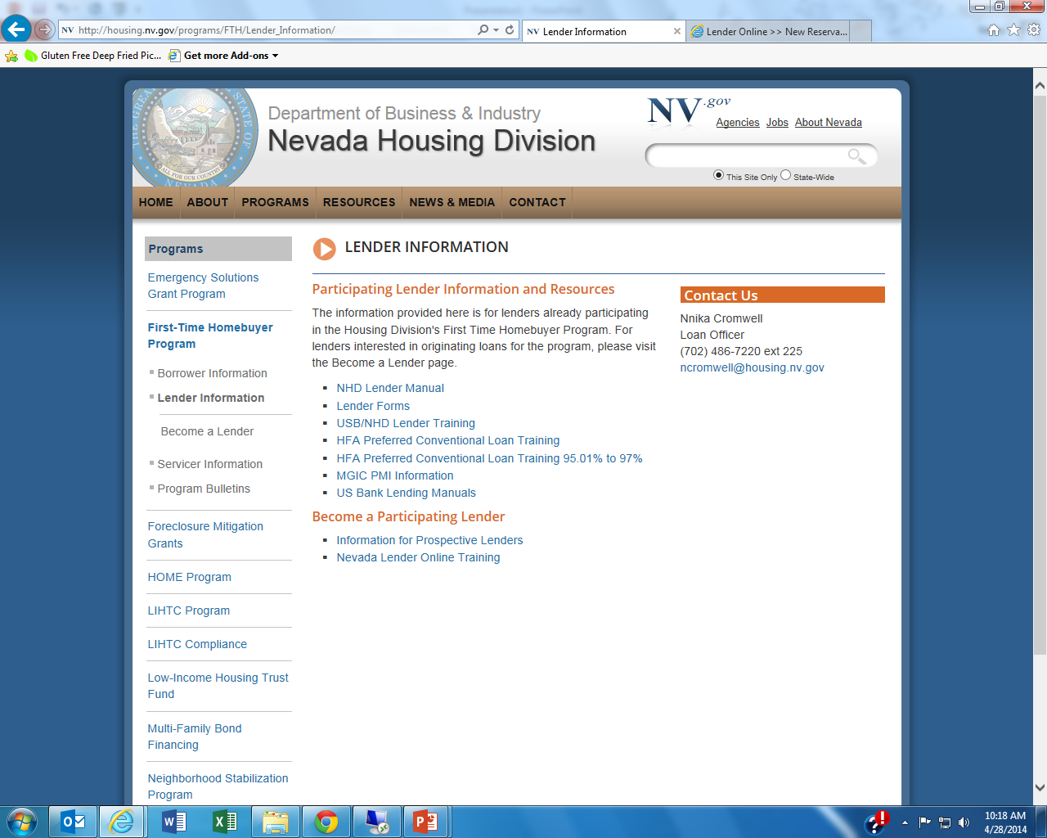

Slide 18
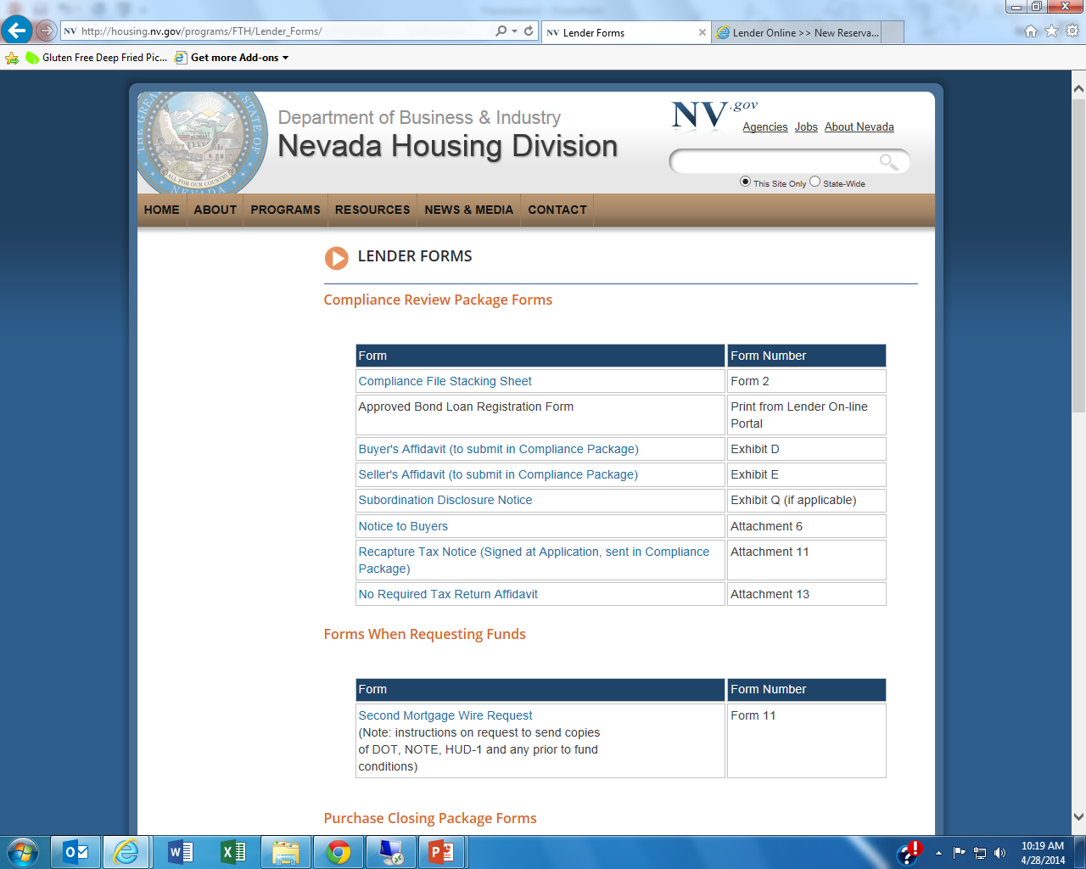

Slide 19
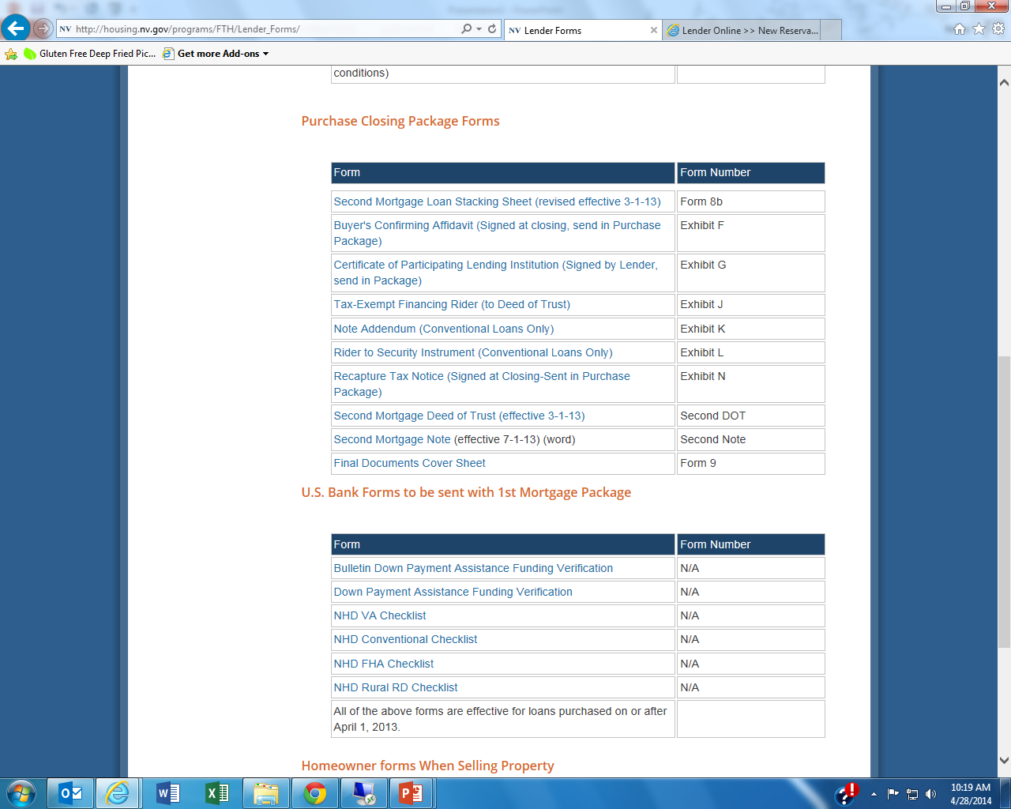

Slide 20
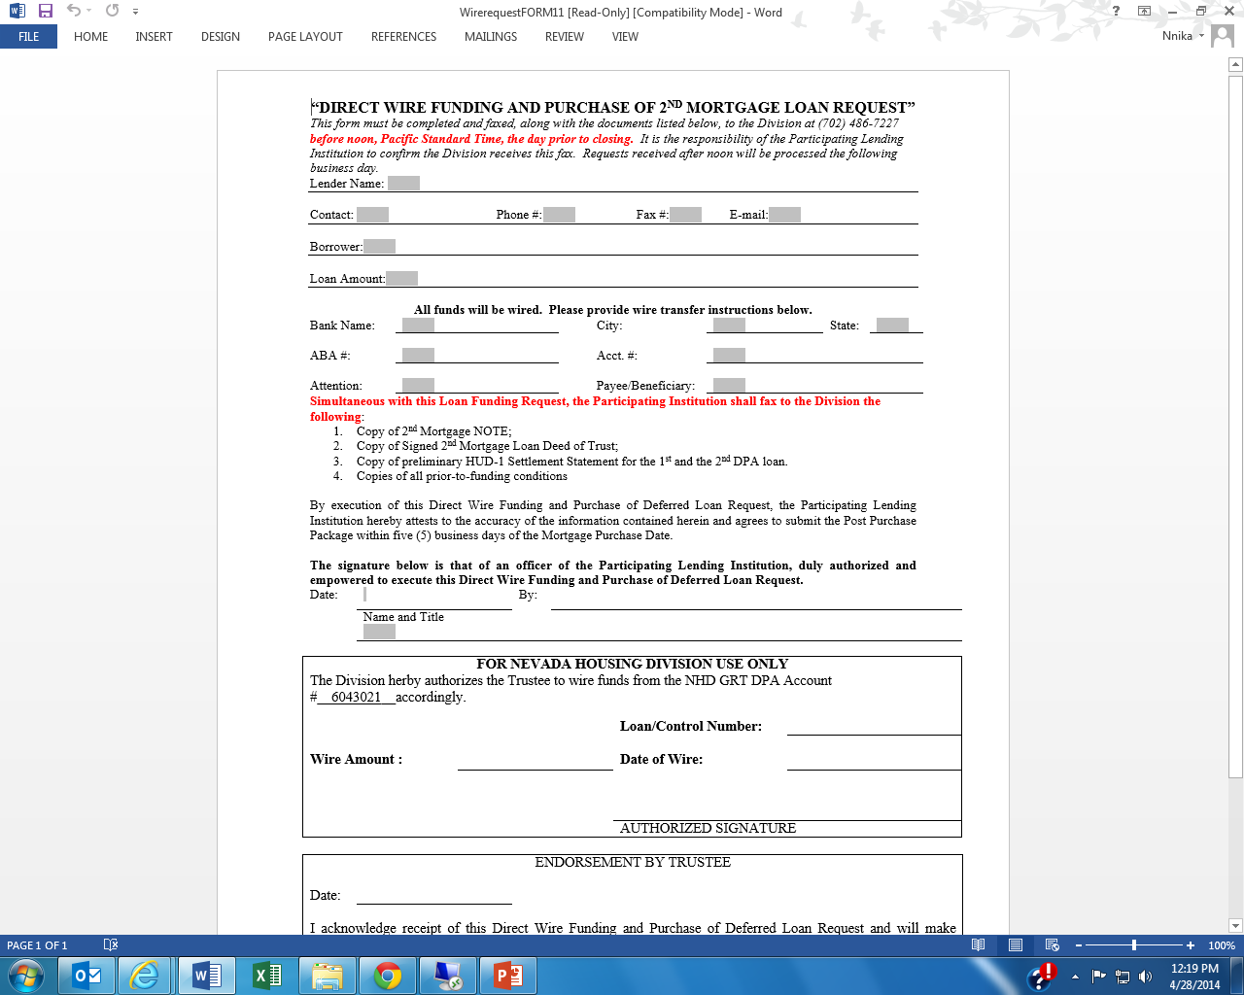

Slide 21
Hero-To-Home for Veterans & Military family members
We're proud to provide the dream of homeownership to our HONORED VETERANS!
The Nevada Housing Division, a Division of the Department of Business and Industry, is pleased to announce that with the passage of the Heroes Assistance and Relief Tax Act of 2008, all exemptions temporarily offered to Veterans are now permanent.
How does this benefit our Honored Veterans?
Qualified Veterans are EXEMPT from First Time Homebuyer requirements
Qualify for below market loans
Lenders can use all eligible loan types for financing and are not limited to just "VA" loans
Who is a qualified Veteran?
Any Veteran that served on active duty, and any Veteran that applied for financing within 25 years of the end of their active service date

Slide 22
Example: Market Hero to Home Hero to Home
Loan $170,000.00 $170,000.00 $195,000.00
Mortgage Rate 4.25% 2.75% 2.75%
Loan Term 30 Years 30 Years 30 Years
Monthly Principal and Interest (does not include taxes and insurance)
$836.30 $694.01 $796.07
Savings $142.29 $40.23

Slide 23
FREQUENTLY ASKED QUESTIONS
Q: Can the veteran/military family member use this loan for refinance transaction?
A: No. This is for purchase only.
Q: Can the veteran/military family member use this loan to purchase a second home or rental property?
A: No. This program is for the purchase of a primary residence only. The purchased home may not be rented out at any time without express written approval from the Division.
Q: I’m a service member or a spouse of a service member who is on his/her first tour of duty and I do not have a DD214. Can I get an exemption to the first-time homebuyer requirement?
A: No you must be a first-time homebuyer to be eligible for the program.
Q: I’ve purchased a home before, but I sold it 3 years ago and I did not use a bond loan to finance it. Would I be considered a First-time homebuyer?
A: Yes you would be considered a first-time buyer if it’s been more than 3 years since you last owned a home as your primary residence and took the interest deduction on your personal tax returns. This same logic would apply if you lost the home due to foreclosure or short sale.
Q: I’ve purchased a home before can I get an exemption from the First-Time Homebuyer Requirement?
A: It depends. Has it been less than 25 years since you last served or left active duty? Have you previously received financing as a first-time homebuyer through a single family mortgage Revenue Bond Program? If you or your service member can answer yes to the first question and have not previously received assistance from a Revenue Bond program then you would qualify for an exemption.
Additionally, the veteran must certify that he or she has not previously obtained a mortgage loan financed by a single family mortgage revenue bond set forth in Section 143(D)(2)(d) of the Code. The veteran / active duty service member must complete a worksheet demonstrating qualification as a veteran and provide copies of discharge papers, or evidencing date veteran left active service. This documentation must be included in the compliance file sent to NHD.
Q: What credit score do I need to have to qualify for this program?
A: Credit score requirements are the same as the Division’s standard down-payment assistance program. Generally speaking, 640 mid-FICO score. Depending on the type of first mortgage you choose and property type (FHA, Conventional, traditional home or manufacturing housing) the credit score requirement may be different. **See the Division’s lender manual or Snapshot brochure on our website at http://housing.nv.gov/programs/First-Time_Homebuyer/ for more details and specific information.
Once you decide which lender you want to work with from our approved list http://housing.nv.gov/uploadedFiles/housingnvgov/content/programs/FTH/ParticipatingLendingInstituionsDec31.pdf , the lender will explain the credit and income requirements for the program.
Q: Is there a maximum or minimum income requirement for the program?
A: Yes there are maximum income guidelines, as well as maximum purchase price guidelines. Please see our Snapshot brochure, lender manual or website for more details. Again the lender will also go over this with you once you submit an application and income documentation. http://housing.nv.gov/uploadedFiles/housingnvgov/content/programs/FTH/STATEOFNEVADA-SNAPSHOTProgramInfo.pdf
Q: Do I have to use a certain lender to take advantage of this program?
A: Yes. Please refer to approved Lender List on our website.
http://housing.nv.gov/uploadedFiles/housingnvgov/content/programs/FTH/ParticipatingLendingInstituionsDec31.pdf

Slide 24
Q: Do I have to use a particular real estate agent to take advantage of this program?
A: No. You are free to work with any real estate professional.
Q: If I use this program will it delay my closing?
A: No. All of our approved Lenders have been trained and know how to process your application. There should not be any delay with your closing.
Q: If I sell my home before a certain time, could I be subject to a penalty or tax?
A: Potentially. In 1990, Congress passed a law requiring a “recapture tax” on the gain, or profit, from the sale of a residence financed with mortgage revenue bond proceeds, under certain circumstance. Borrowers are subject to the possibility of a recapture tax if the property is sold within 9 years after closing. The maximum recapture tax that can ever be paid is 6.25% of the original mortgage amount or 50% of the gain realized on the sale of the property, whichever is less. The recapture tax represents an additional tax liability, payable with the homeowner’s federal income taxes. Your lender can explain more about it. In some circumstances the Division allows borrowers to apply for a reimbursement of the tax, should it be required. ** Certain restrictions apply.
Q: When calculating a service member income does the Division count BAH and BAS?
A: Yes the Division will count ALL income and allotments received as a part of the household income.

Slide 26
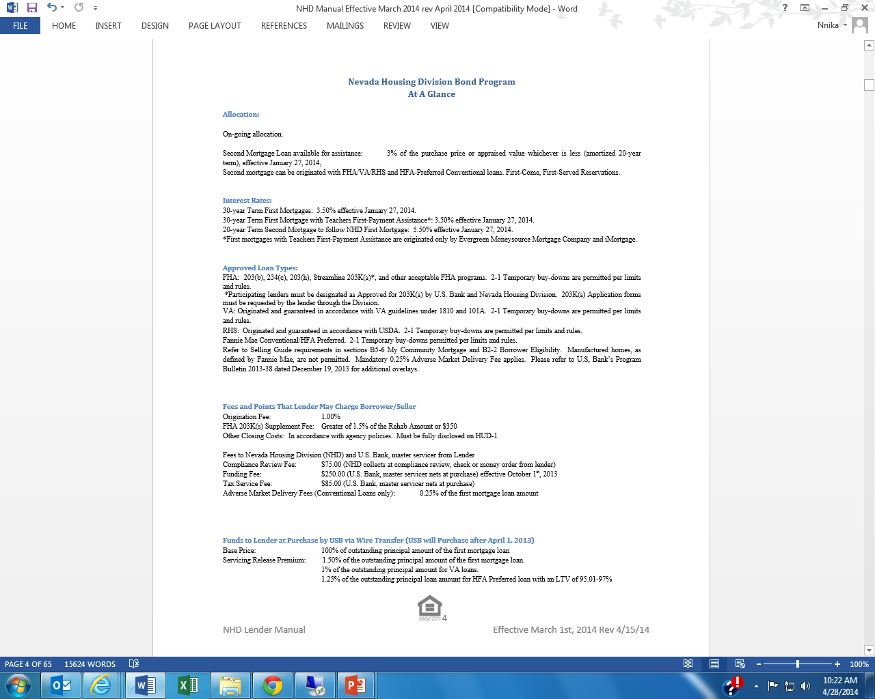

Slide 27
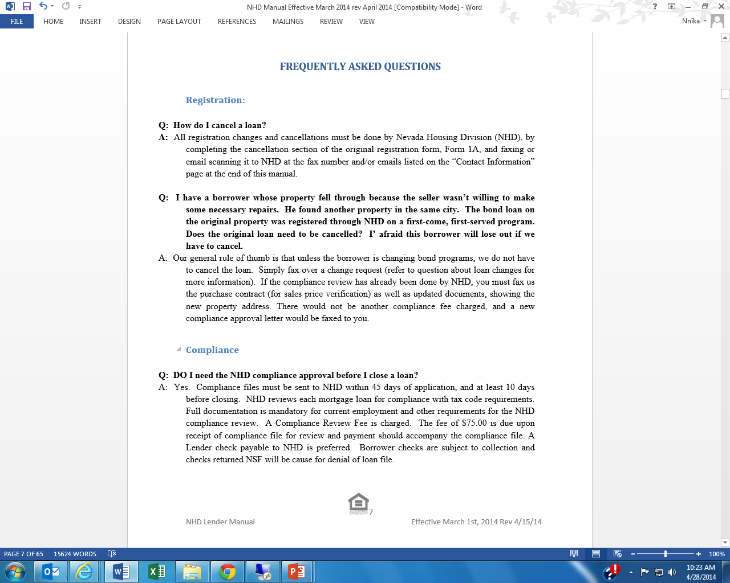

Slide 29
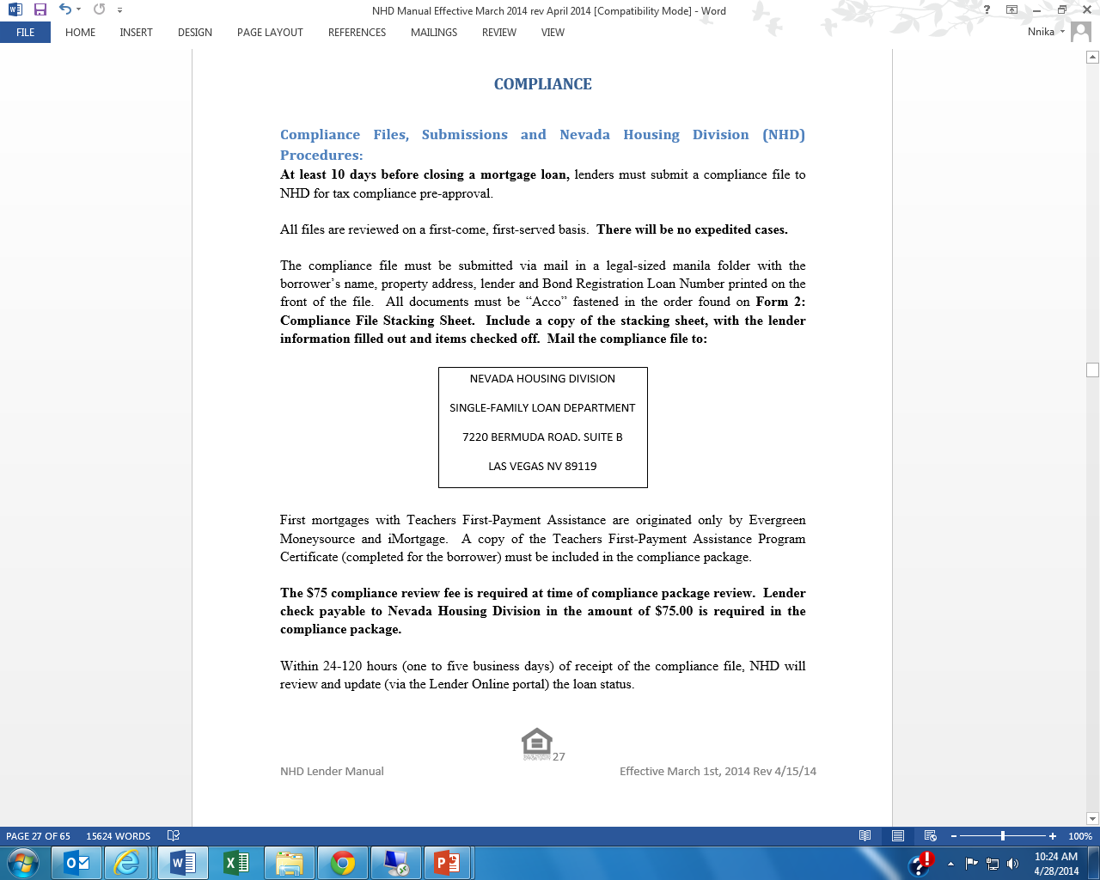

Slide 30
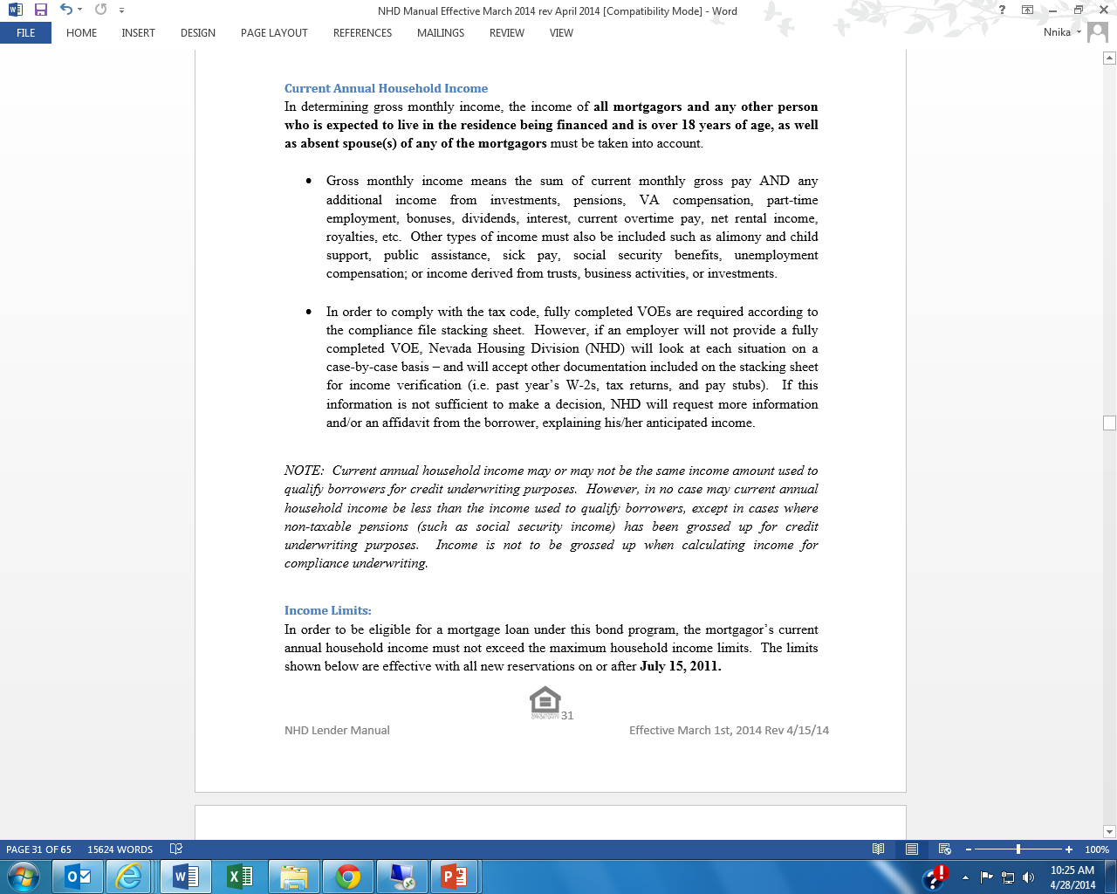

Slide 31
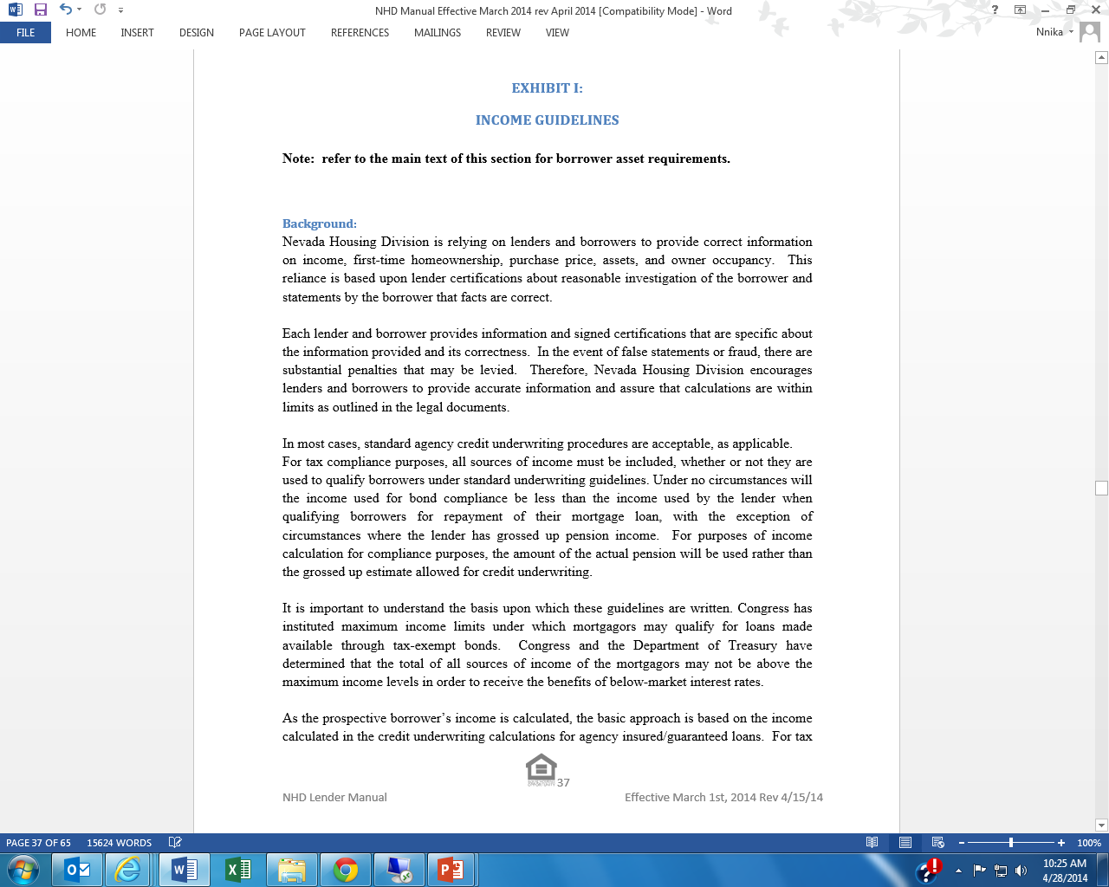

Slide 32
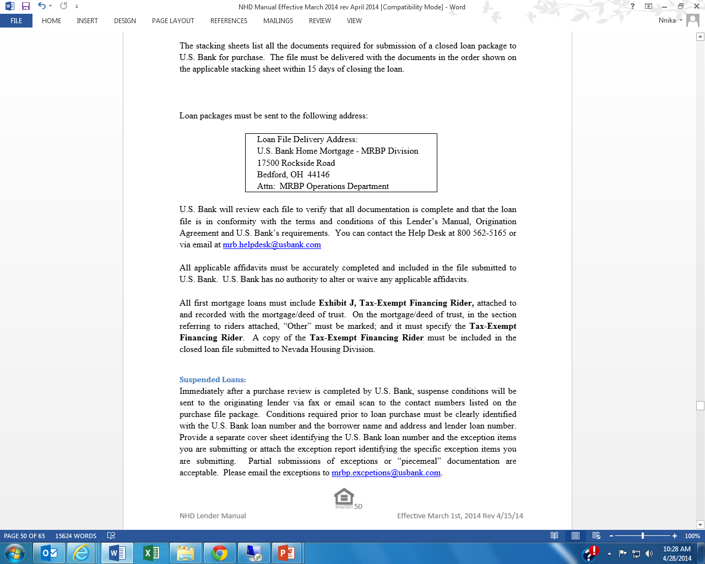

Slide 33
