Slide 1
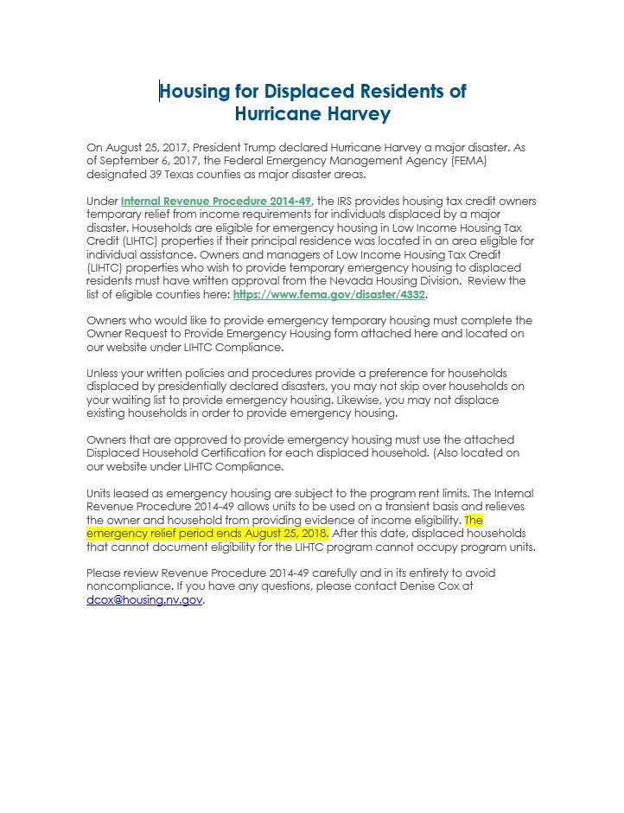
Housing for Displaced Residents of
Hurricane Harvey

Slide 2
Housing for Displaced Residents of
Hurricane Harvey

Slide 3
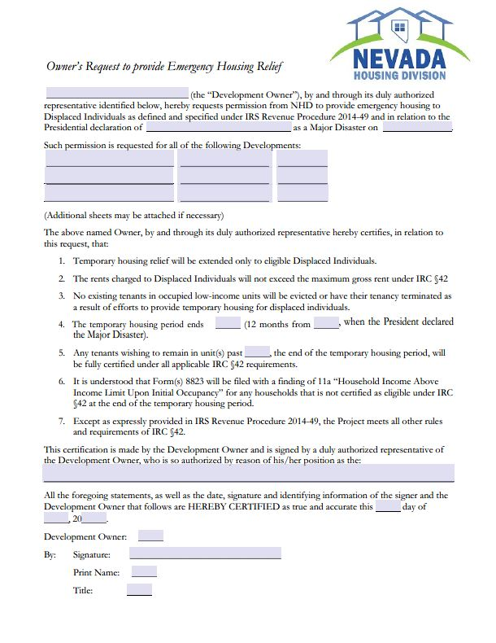
Owner’s Request to Provide Emergency Housing Relief

Slide 4
Owner’s Request to Provide Emergency Housing Relief

Slide 5
Owner’s Request to Provide Emergency Housing Relief

Slide 6
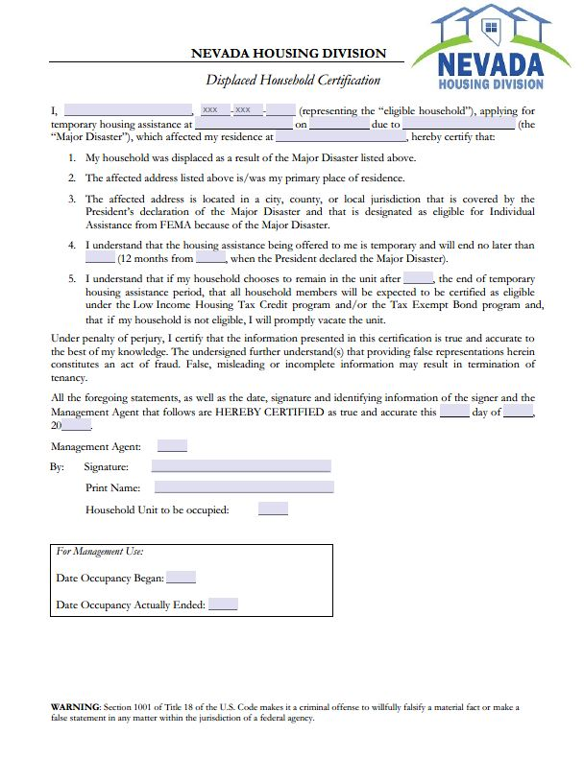
Displaced Household
Certification

Slide 7
Displaced Household
Certification

