Slide 1
Fair Housing in Focus
LIHTC Basics & Reasonable
Accommodations

Slide 2
Overview:
LIHTC Basics
  Applicable Fair Housing Laws
Reasonable Accommodation/Modification
  Policy Guidelines

Slide 3
LIHTC Basics
Knowing Which Regulations Apply is Key

Slide 4
Q: Which Fair Housing Laws are applicable to
Low–Income Housing Tax Credit Properties?
A:
A. Fair Housing Act as amended in 1988 (CFR Part 8)
B. Americans with Disabilities Act
C. Section 504 of the Rehabilitation Act of 1973 (CFR Part 100 et seq)
D. All of the above
E. None of the above

Slide 5
Q: Which Fair Housing Laws are applicable to
Low–Income Housing Tax Credit Properties?
A:
A. Fair Housing Act as amended in 1988 (CFR Part 8)
B. Americans with Disabilities Act
C. Section 504 of the Rehabilitation Act of 1973 (CFR Part 100 et seq)
D. All of the above
E. None of the above

Slide 6
Q: Which Fair Housing Laws are applicable to
Low–Income Housing Tax Credit Properties with additional federal assistance?
A:
A. Fair Housing Act as amended in 1988 (24 CFR Part 8)
B. Americans with Disabilities Act
C. Section 504 of the Rehabilitation Act of 1973 (24 CFR Part 100 et seq)
D. All of the above
E. None of the above

Slide 7
Q: Which Fair Housing Laws are applicable to
Low–Income Housing Tax Credit Properties with additional federal assistance?
A:
A. Fair Housing Act as amended in 1988 (24 CFR Part 8)
B. Americans with Disabilities Act
C. Section 504 of the Rehabilitation Act of 1973 (24 CFR Part 100 et seq)
D. All of the above
E. None of the above

Slide 8
Fair Housing Act At‐a‐Glance
Applicable whether or not the housing is provided through a federal program
Seven protected classes
Exemption from Familial Status requirement for
“housing for older persons 55 years of age and
older”
Reasonable Accommodation/Modification are key issues

Slide 9
Seven Protected Classes + 1
Race
Color
Religion
Sex
National Origin
Disability
Family Status
Nevada: Transgender

Slide 10
ADA At‐a‐Glance
Extends the protections first regulated under the Fair Housing Act to the marketplace
Title III – Public Accommodations
  Applies to common areas of property open to general public
Title II – Activities of Public Entities
  Requires public entities to make both new and existing housing facilities accessible to persons with disabilities.

Slide 11
Section 504 At‐a‐Glance
Prohibits discrimination on the basis of disability in programs and activities receiving federal funds.
Programs and services be conducted in the most integrated setting appropriate.
Requires designation of a Section 504 Coordinator.
Requires Section 504 Self Evaluations and Transition Plans

Slide 12
Other Civil Rights Laws
Many states have enacted additional protected classes (i.e., Sexual Orientation, Marital Status, etc.)
When there is a conflict between federal and state civil rights laws, the regulation that is “the most stringently protective of the protective class” will apply.

Slide 13
Reasonable Accommodation/Modification
Establishing Policy is Key

Slide 14
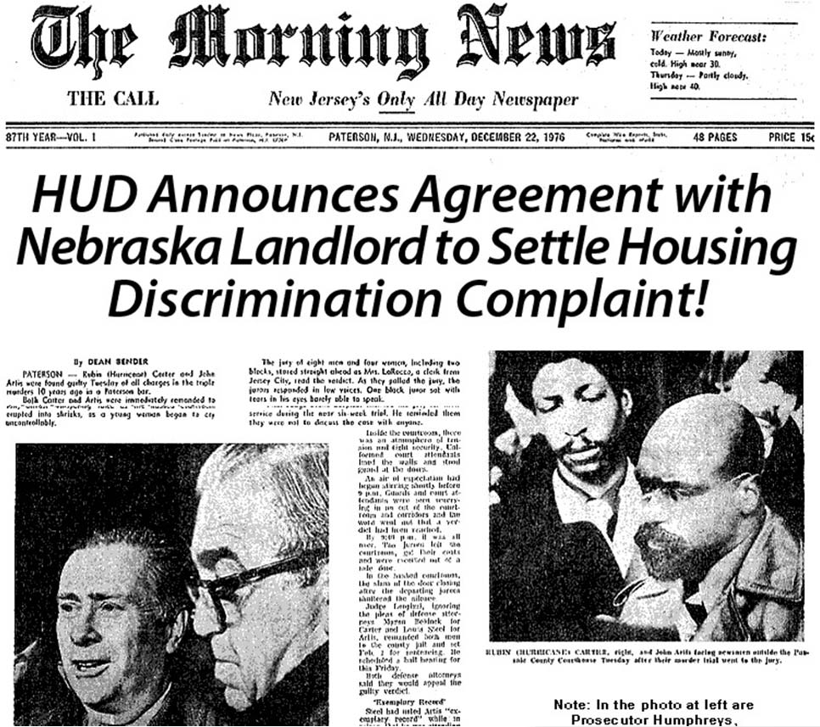
A Cautionary Tale
Resident sought unit transfer as reasonable accommodation for disability
Request was denied resulting in injury to resident

Slide 15
Terms of Settlement:
Pay resident $22,500
Revise policies and designate a Section 504 Coordinator
Redesign an accessible unit on an accessible route with accessible parking to meet UFAS requirements
Alter seven designated accessible parking spaces
Owner, managing agent and staff to attend FHA and Section 504 training.

Slide 16
Reasonable Accommodations
“It is unlawful for any person to refuse to make a reasonable accommodation in rules, policies, practices, or services, when such accommodations may be necessary to use and enjoy a dwelling unit, including public and common use areas” (24 CFR 100.204(a))

Slide 17
Reasonable Modifications
“It is unlawful for any person to refuse to permit, at the expense of a handicapped person, reasonable modifications of an existing premises if the proposed modifications are necessary to afford the handicapped person full enjoyment of the premises of a dwelling” (24 CFR 100.203(a))

Slide 18
Why Have a Policy?
Helps individuals with disabilities in making requests
Help you assess requests in a uniform manner
Provides record to show that requests receive proper consideration

Slide 19
Reasonable Accommodation/Modification Policies
HUD strongly recommends
Dangers associated with accommodating all requests
Absence of policy can equate to having no basis for denying requests
Should contain 3 main components:
  Mission Statement
  Definitions
  Process

Slide 20
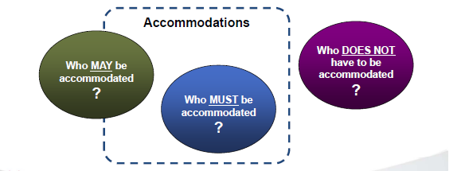
Boundaries to keep in mind:

Slide 21
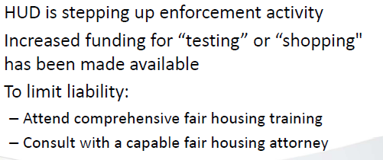
In conclusion:

Slide 22
Questions?

