Slide 1
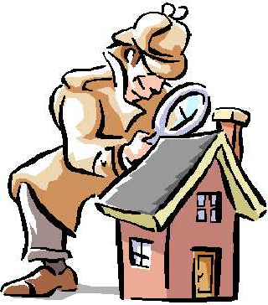
PROCEDURES FOR PHYSICAL INSPECTIONS
Compliance Audit Investigator (Inspector) will:
Provide random sample list of units to property upon arrival
Explain to property representatives how the inspection will be conducted (e.g. representative will accompany inspector at all times and make introductions)
Move in the same direction
throughout the perimeter of the unit

Slide 2
Cont.
Identify each deficiency verbally
Request that property representatives refrain from fixing items to be inspected before the inspector has the opportunity to make an assessment

Slide 3
Cont.
Property Representative will:
Bring a notepad so they are able to record also
Always enter buildings, units and closed rooms (e.g. bedrooms, bathrooms) first
Have keys to all locks including utility closets etc.
Clear paths to doors, rooms, windows
Clear surfaces of items so inspector can make assessment

Slide 4
Cont.
In order to expedite the process a property representative may:
Open sink cabinets
Turn on water in sinks, tubs
Open blinds
Open utility and laundry doors
Open breaker boxes

Slide 5
Cont.
Additionally, a property representative may be asked to:
Install light bulbs to prove a fixture works
Plug in an exhaust fan
Light a gas stove if pilot light is out
Test items more than 8” above the floor (e.g. smoke detectors, windows, emergency lighting, exit signs)

Slide 6
Cont.
When inspection is complete Inspector will:
Detail deficiencies in an exit interview with property representatives
Leave a “Summary of physical inspection findings” that indicates the cure period for each deficiency

